Slide 1


Data Analytics for Managers Instructors: Richard Dunks and Julia Marden
18 October 2016
Notes:
The overall goal of the class is to create a relevant and meaningful experience for the participants in how data analytics can help inform city operations. The class is structured around roughly 50 minute sessions, with a 5 minute break around the 25 min mark and a 10 minute break before the hour. Most sessions start with a group structured ideation exercise where they discuss a topic based on some seed questions, share their best ideas with the group on Post-It Notes, which I then curate and use for a facilitated discussion after they return from break. That carries us through for 25mins until we take a 10 minute break and then start a new block.
The goals and key takeaways are presented at the beginning and end of each block so the participants know what will be covered and there will be facilitated discussion around the relevance of these goals and how well they were met. The point is to have an ongoing check-in on the learning process and how well the goals are being achieved, as well as an overall assessment of how relevant the goals are to their own job and career interests.
There is a tentative timing on the slides, but no plan survives first encounter with a class. The timing is such that each class ends around 4:30pm, with an hour lunch, providing plenty of slack when a block runs over.

Slide 2
Welcome
Notes:
9:00 – 9:05

Slide 3
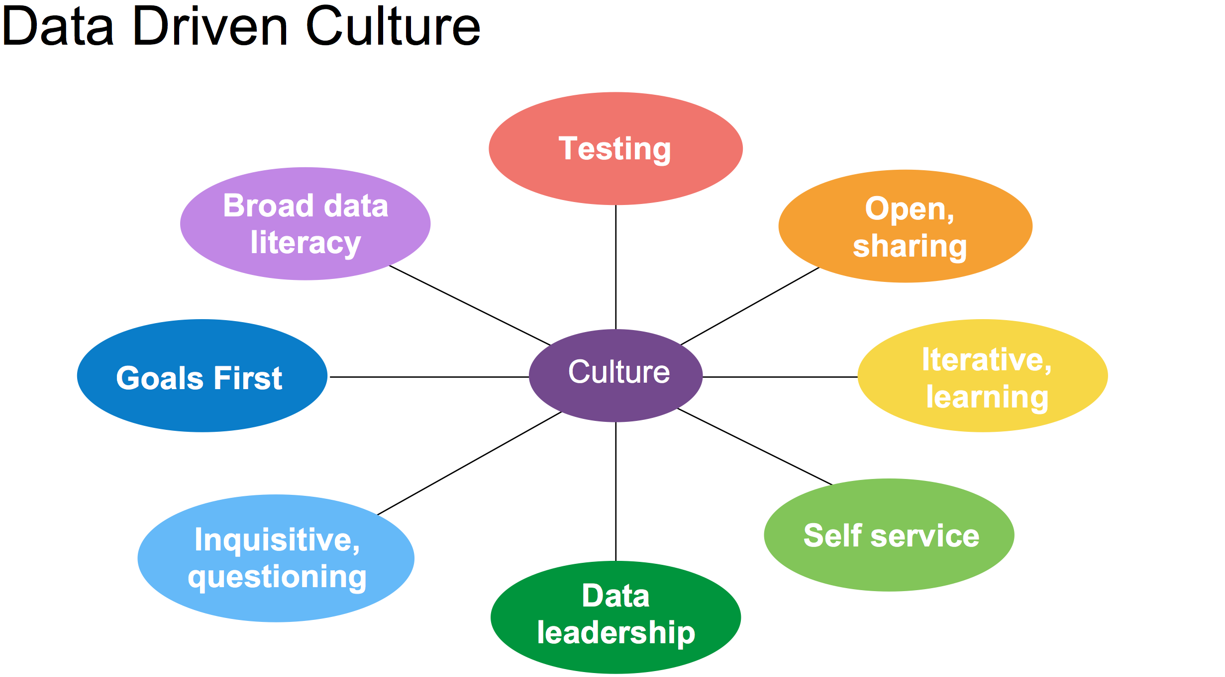

Slide 4
Introductions
Turn to your neighbor and introduce yourself with the following:
Name
Agency and Office
What’s the most interesting data related project you’ve worked on?
You will introduce them to the class
Notes:
9:05 – 9:15
Introduce myself to the class, my background and experience.

Slide 5
What to Expect for Today
9:15 – Welcome and Introductions
9:45 – Data Driven Government
10:30 – 15 min break
10:45 – Data Analytics and the Data Driven Culture
12:00 – Lunch
1:00 – Data Analytics Process and Open Data
1:55 – 5 min break
2:00 – Data Analytics Exercise
2:50 – 10 min break
3:00 – Data Analytics Exercise (continued)
4:30 – Dismissal
All times approximate
Notes:
9:18

Slide 6
Housekeeping
We’ll have one 15 minute break in the morning
We’ll have an hour for lunch
We’ll try for two breaks in the afternoon
Class will start promptly after breaks
Feel free to use the bathroom if you need during class
Please take any phone conversations into the hall to not disrupt the class

Slide 7
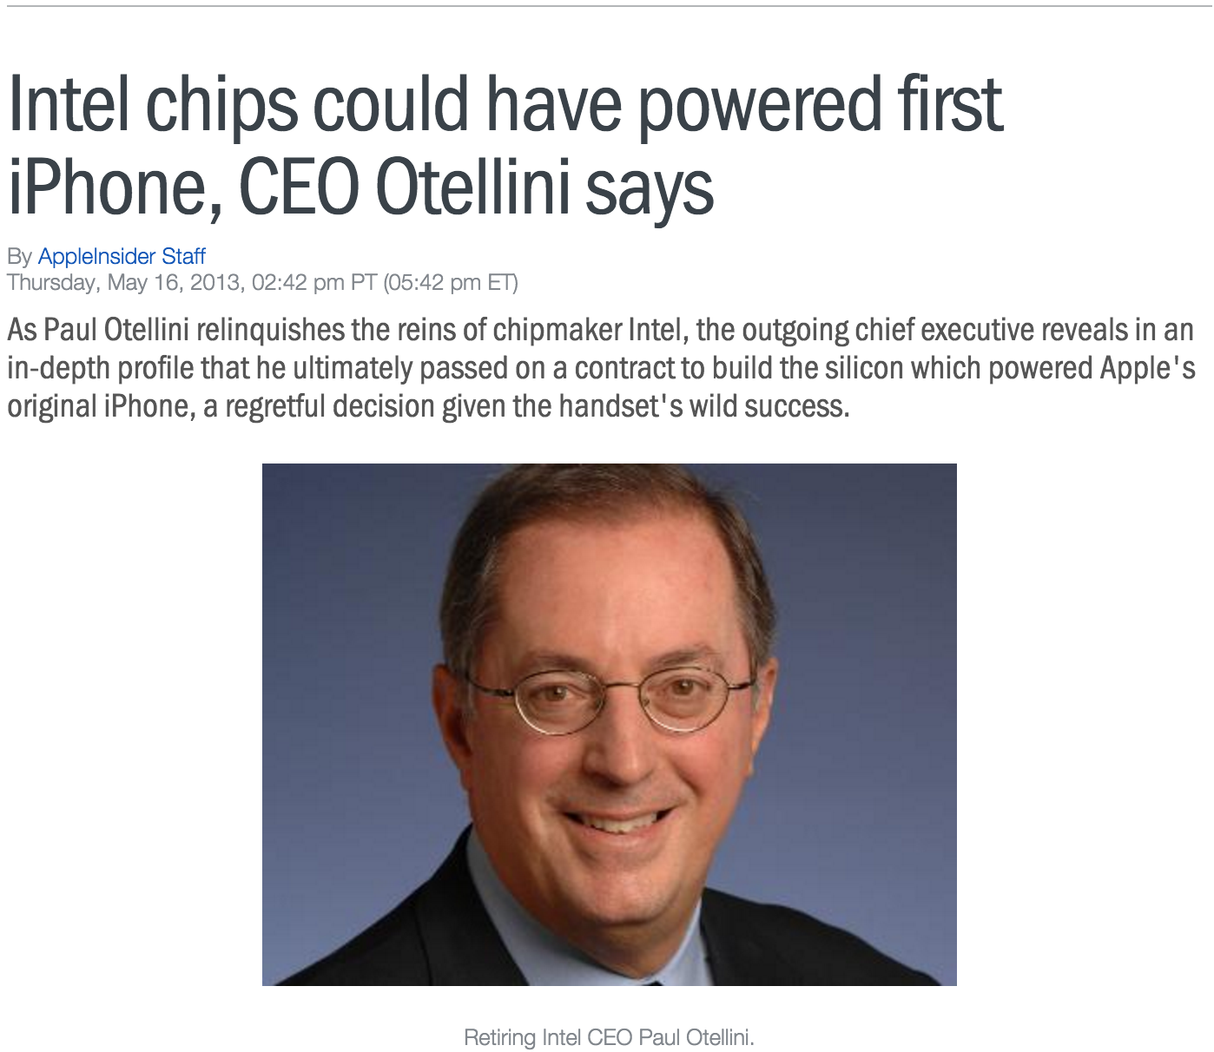
http://appleinsider.com/articles/13/05/16/intel-chips-could-have-powered-first-iphone-ceo-otelini-says

Slide 8
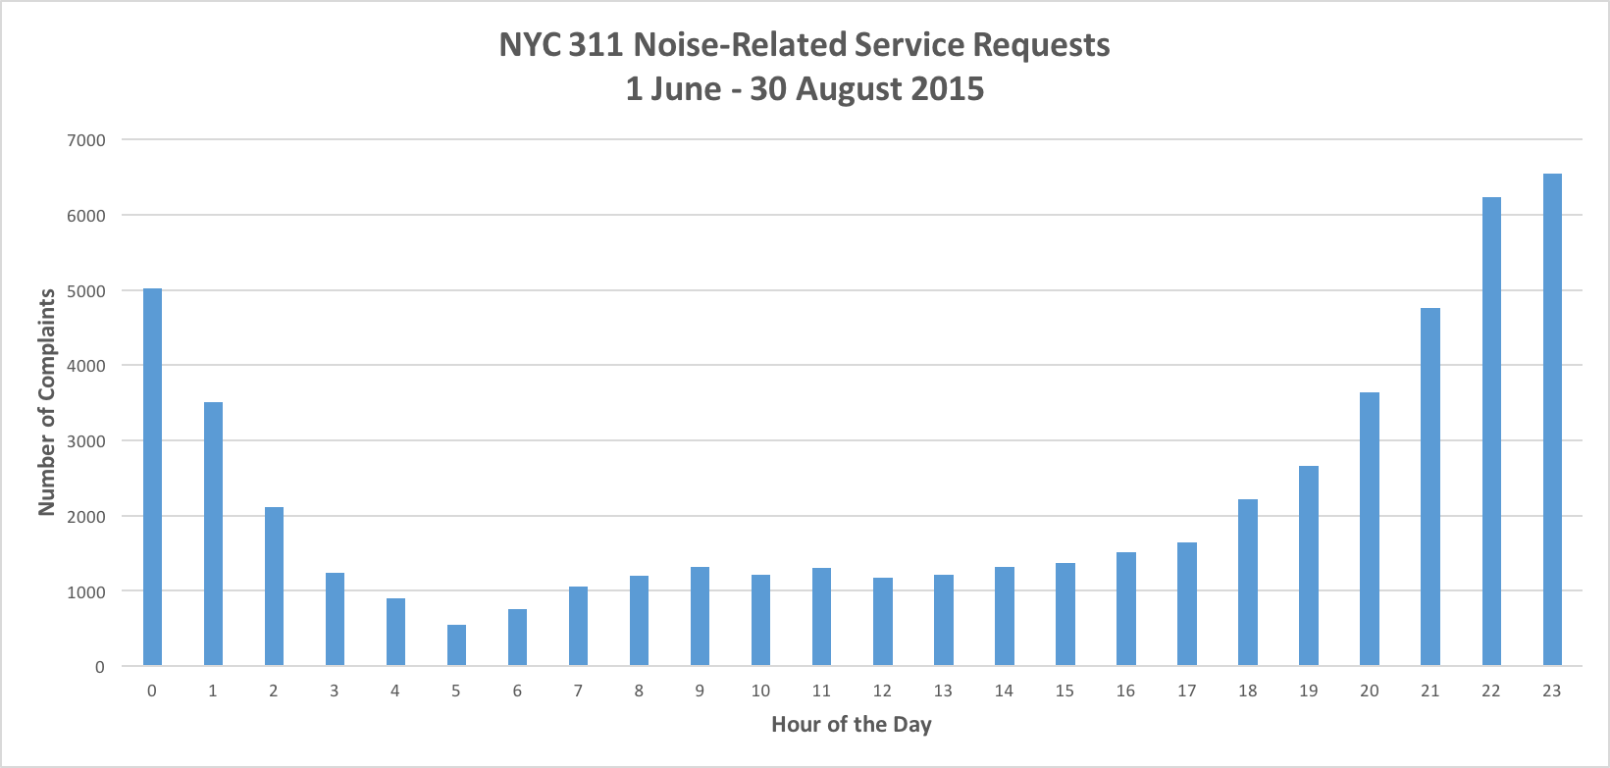
The Value of Data
Data describes phenomena of interest
Can describe the phenomena directly or indirectly

Slide 9
Are all data points created equal?

Slide 10

Facts do not "speak for themselves." They speak for or against competing theories. Facts divorced from theory or visions are mere isolated curiosities.
― Thomas Sowell,
A Conflict of Visions

Slide 11
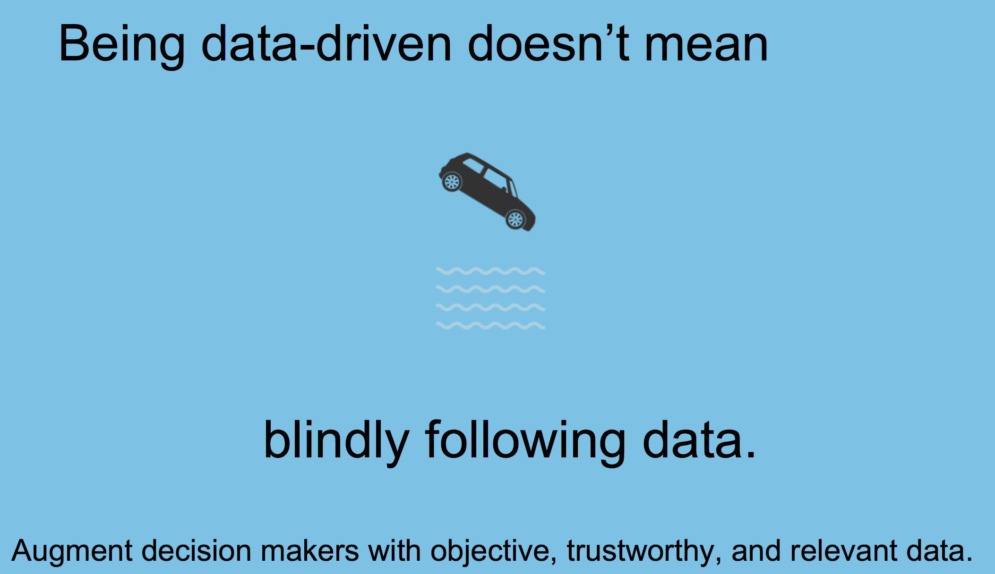

Slide 12
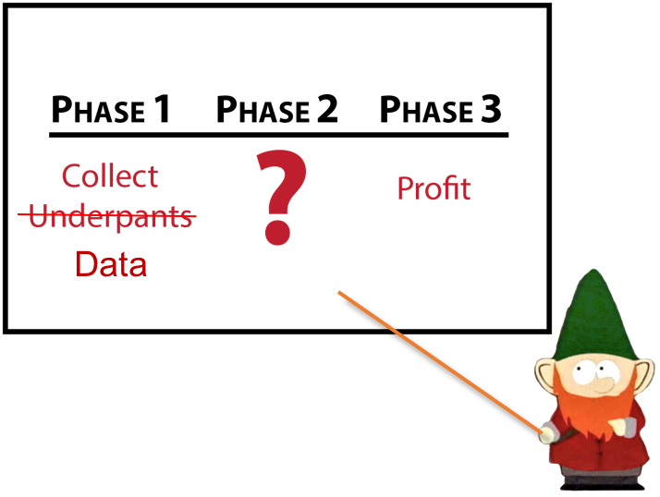

Slide 13
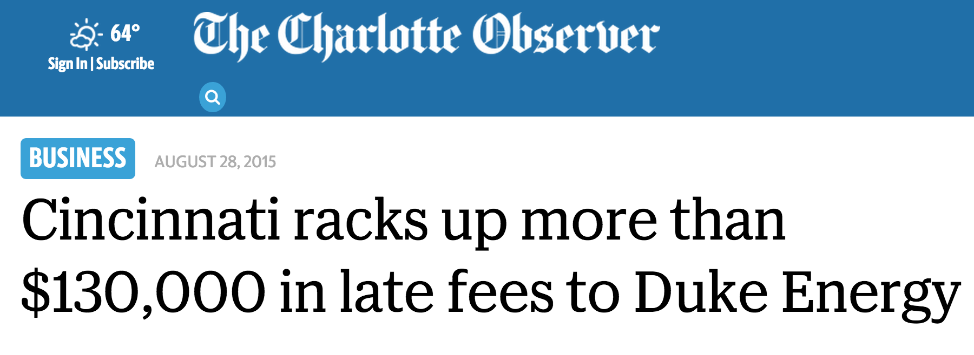
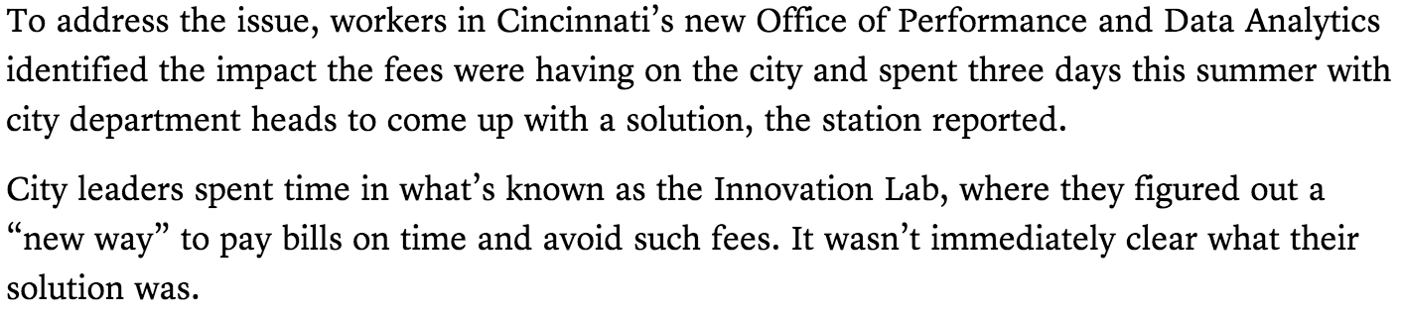
Source: http://www.charlotteobserver.com/news/business/article32617293.html

Slide 14
What is Analysis?
“Analysis is simply the pursuit of understanding, usually through detailed inspection or comparison”
- Carter Hewgley, Director of Analytics, Center for Government Excellence

Slide 16
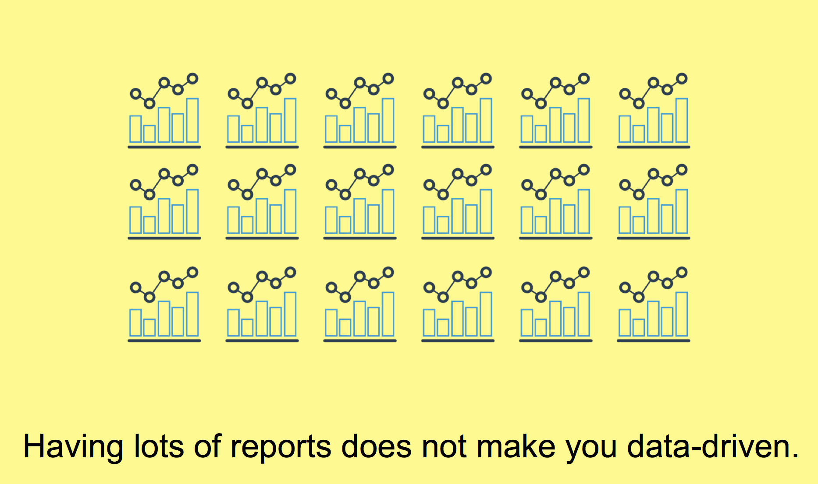

Slide 17
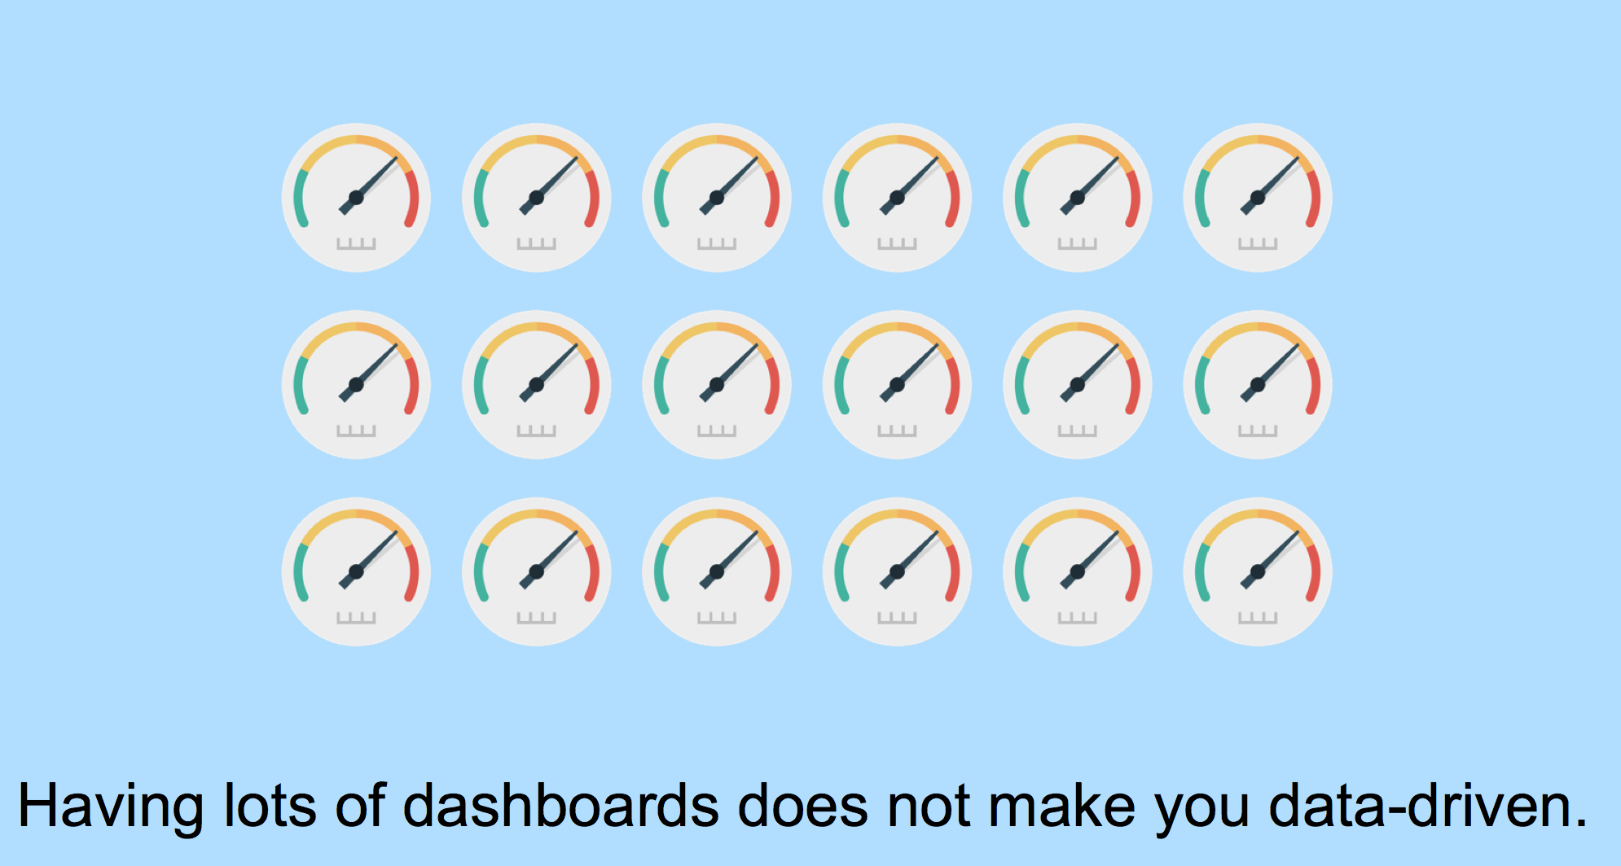

Slide 18
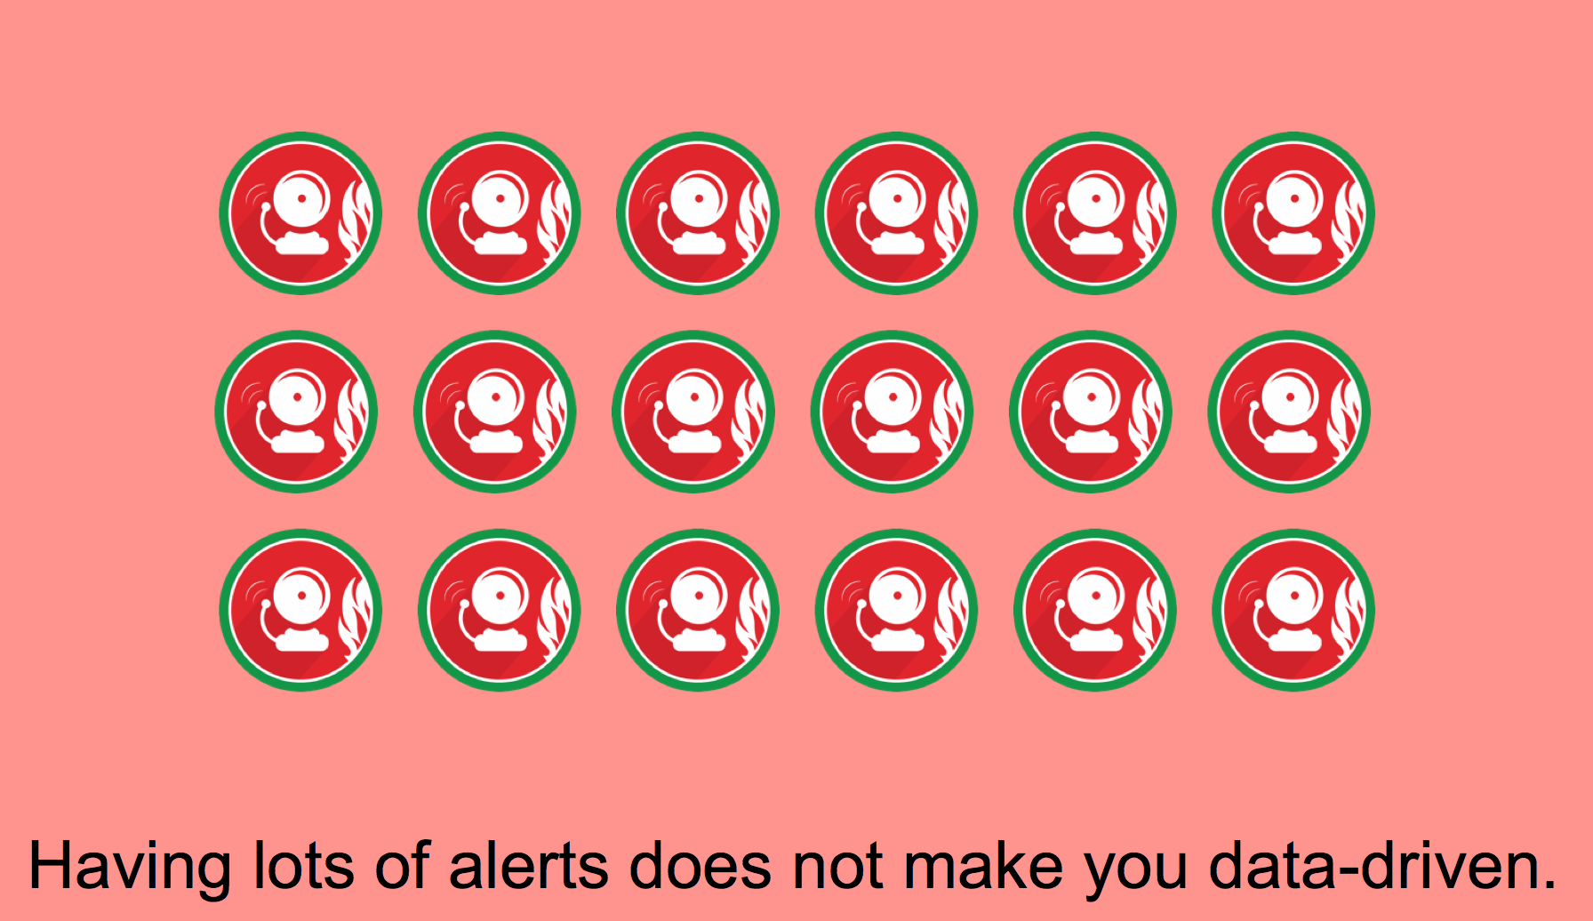

Slide 19
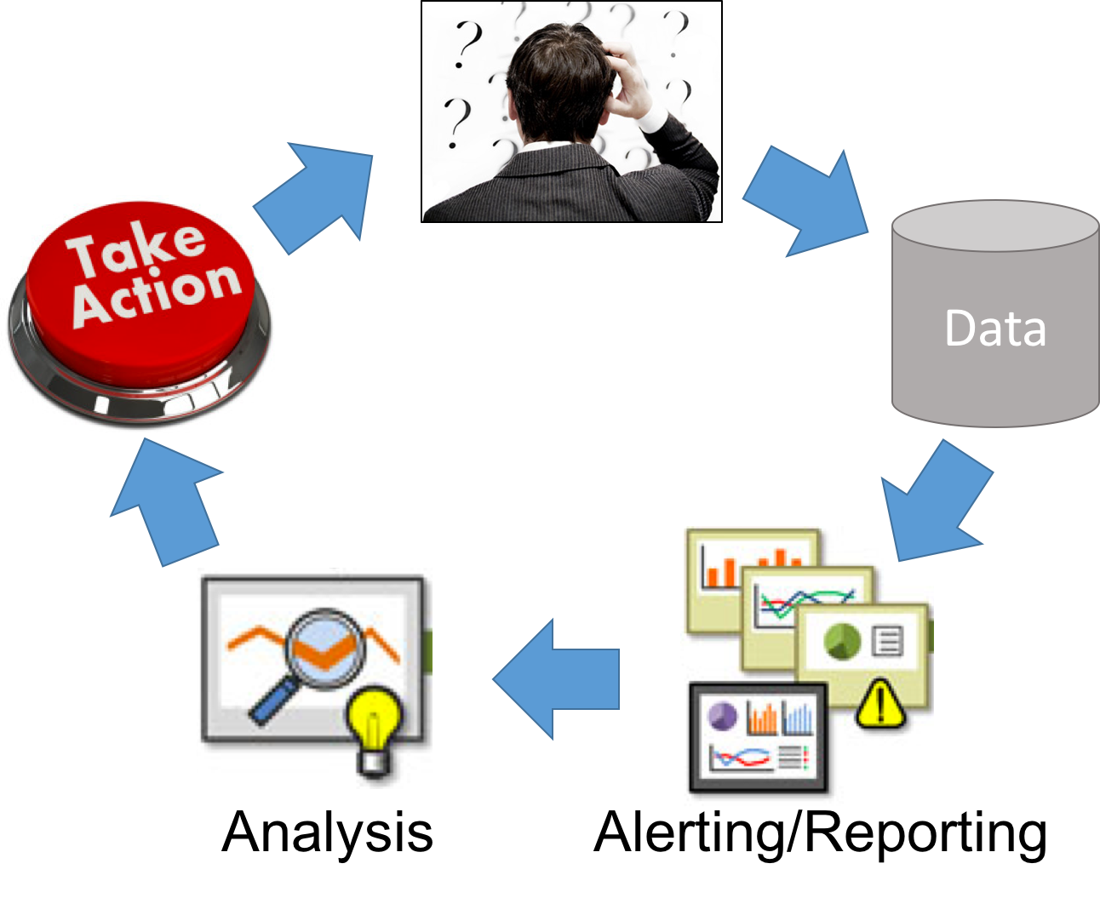
Analytics Value Chain

Slide 21
Types of Analysis
Notes:
9:25 – 9:50

Slide 22
1. Quantifying Needs
How much of X do I need?
Analyzing inputs (resources, people, etc.)
How much does my need change given a different set of conditions?
What are the conditions that influence X?
Important Considerations:
How does X play into my organization’s mission and goals?
What’s the most meaningful way of quantifying X?
Notes:
9:25 – 9:50

Slide 23
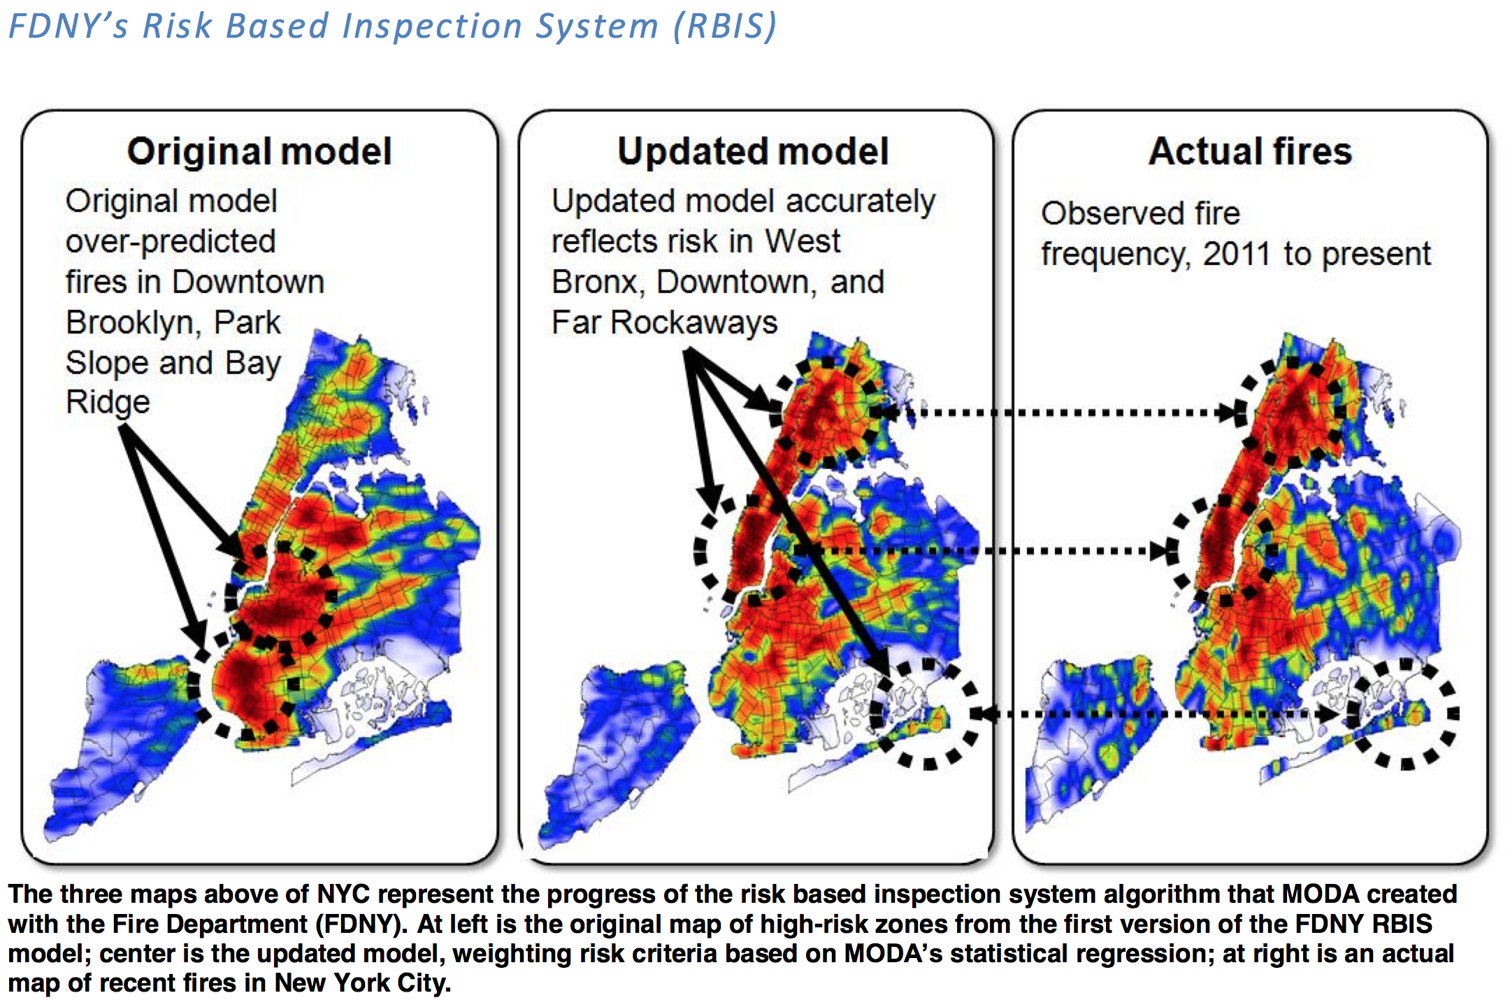
Source: NYC Mayors Office of Data Analytics – 2013 Annual Report
http://www.nyc.gov/html/analytics/downloads/pdf/annual_report_2013.pdf

Slide 24
2. Operational Analysis
What is my organization doing?
Assessment
How might my organization do things better?
Important Considerations:
What are your organization’s mission and goals?
How do your employees do their work?
What’s the best way to measure this work?
Notes:
9:25 – 9:50

Slide 25
3. Performance Metrics
How is my organization doing?
Monitoring and evaluation
How do we make this data visible to the people who need it?
Important Considerations:
What is most important to measure (think mission and goals)?
How do we best measure performance?
“When a measure becomes a target, it ceases to be a good measure” - Charles Goodhart
Notes:
9:25 – 9:50

Slide 26
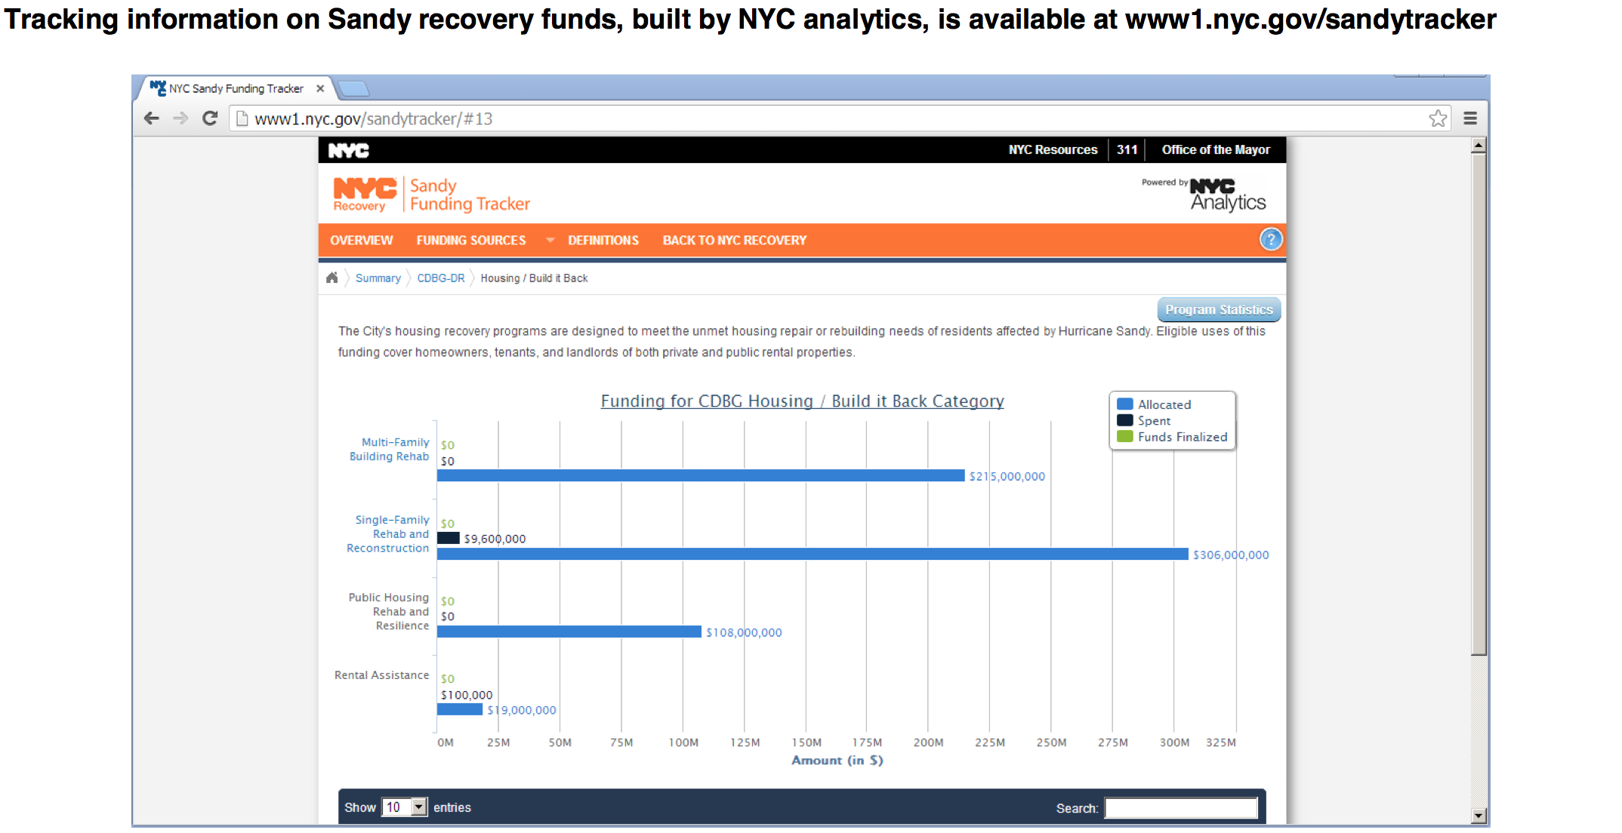
Tracking Hurricane Sandy Relief Funds
Source: NYC Mayors Office of Data Analytics – 2013 Annual Report
http://www.nyc.gov/html/analytics/downloads/pdf/annual_report_2013.pdf

Slide 27
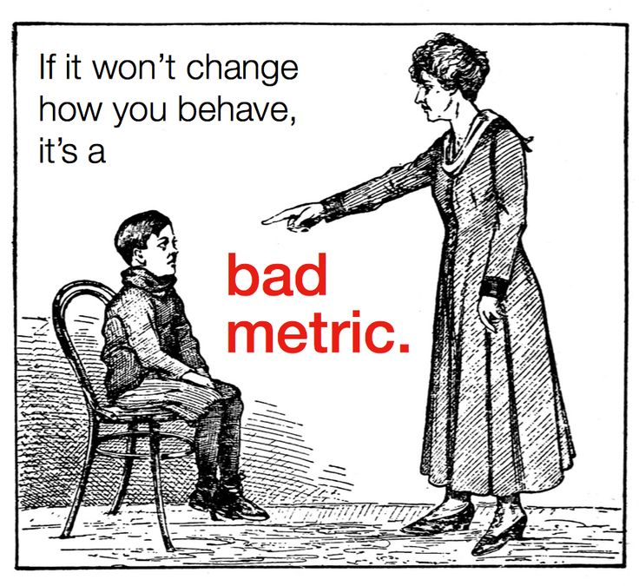
Source: http://www.slideshare.net/Leananalytics/startup-metrics-toronto-march-19

Slide 28

Goodhart’s Law
“When a measure becomes a target, it ceases to be a good measure.”
Charles Goodhart, Economist
https://philebersole.wordpress.com/2013/01/10/goodharts-law-on-not-going-by-the-numbers/

Slide 29
4. Prioritization
How do I meet optimal outcomes with limited resources?
Optimizing allocation
Important considerations:
Minimize disruption
Work within current workflow
Support existing business practices
Notes:
9:25 – 9:50

Slide 30
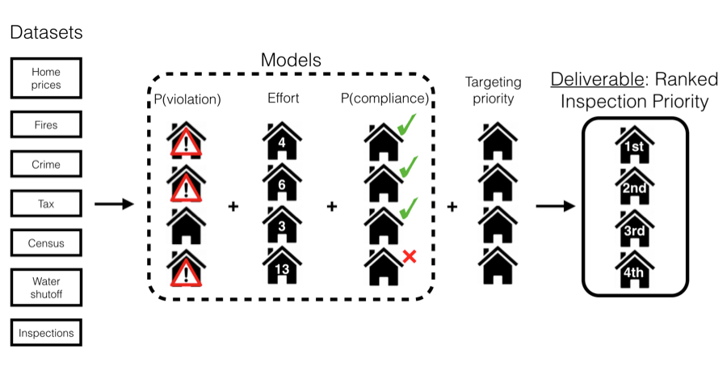
Cincinnati Blight Prevention Model
http://dssg.uchicago.edu/2015/08/20/cincy-blight-prevention.html

Slide 31
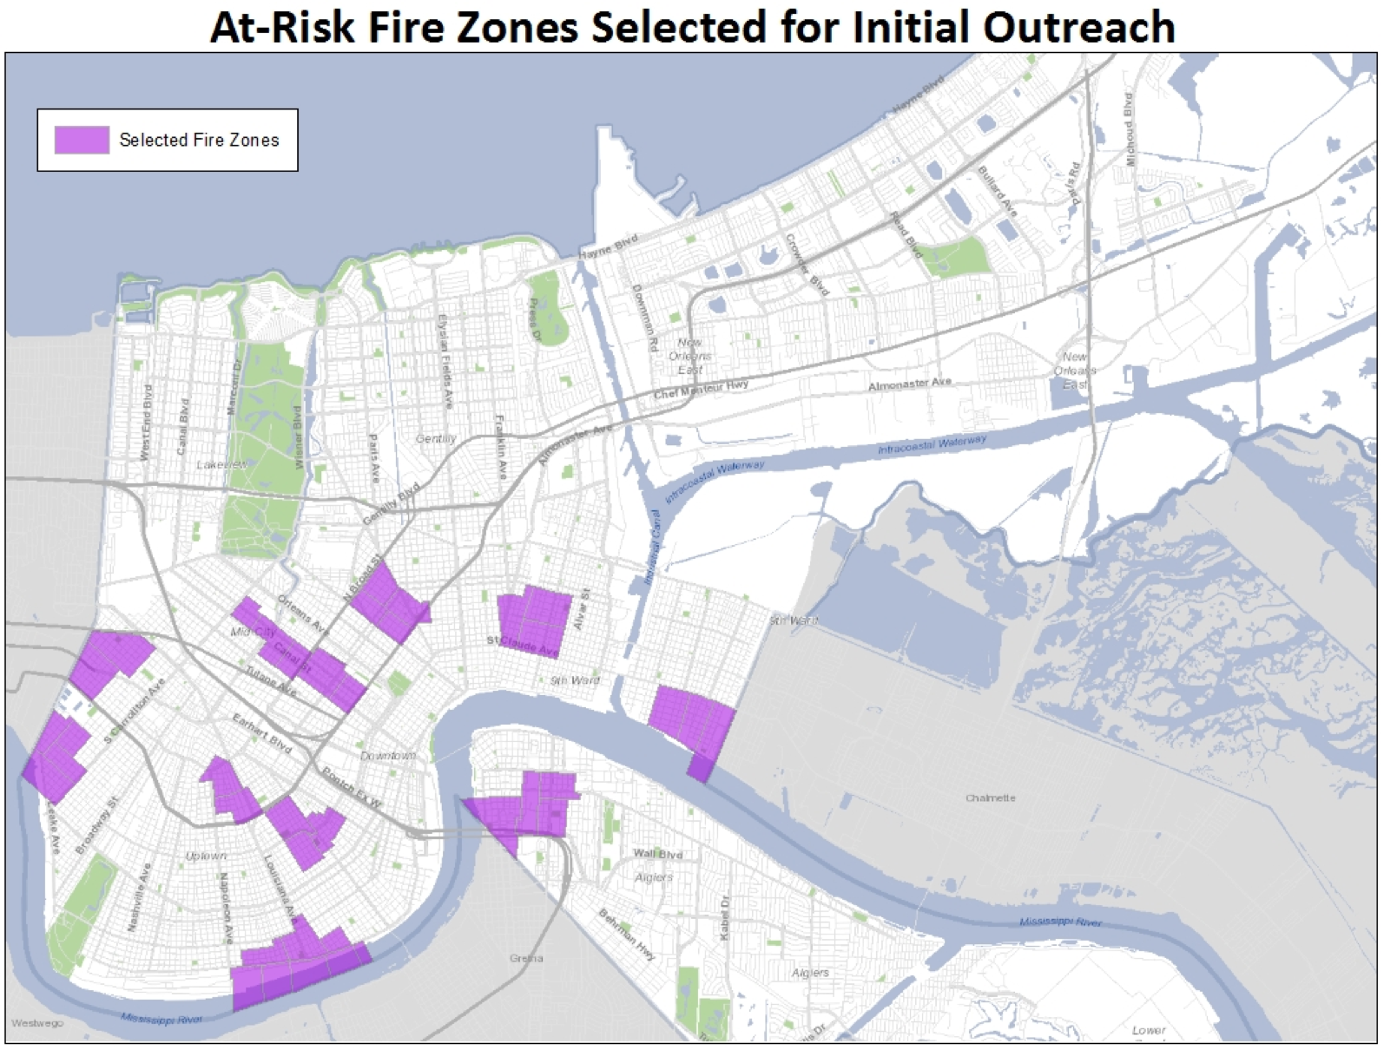
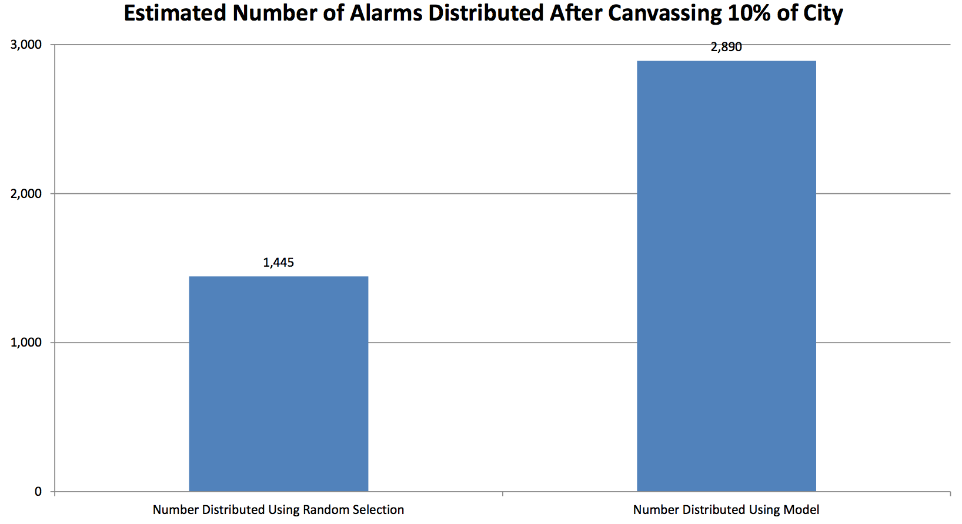
New Orleans Smoke Alarm Targeted Outreach
http://www.nola.gov/performance-and-accountability/nolalytics/files/full-report-on-analytics-informed-smoke-alarm-outr/

Slide 32
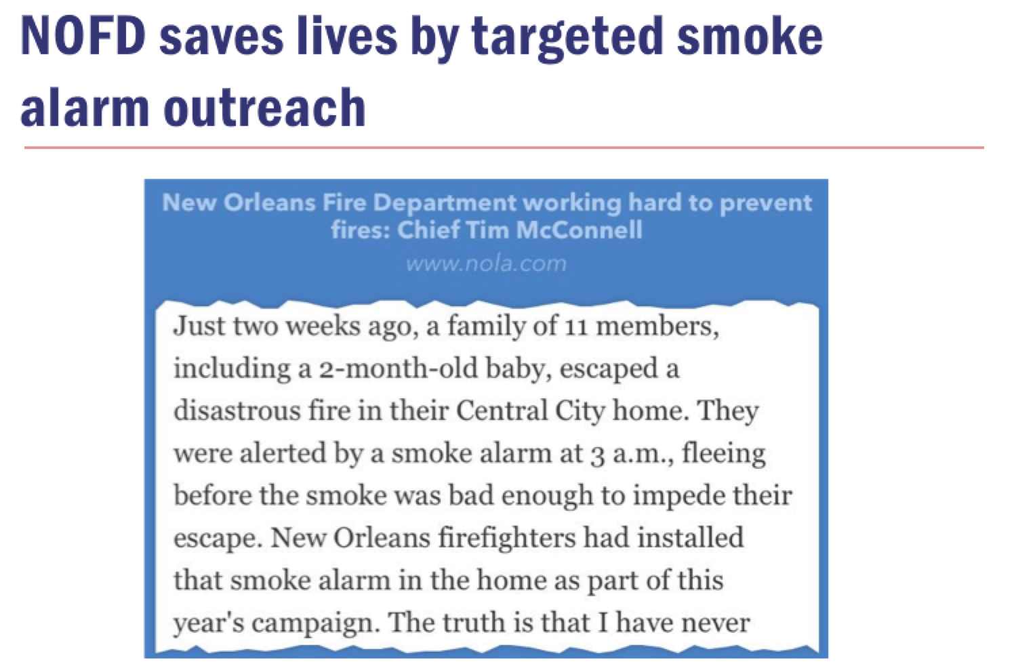
http://www.nola.com/politics/index.ssf/2015/10/new_orleans_fire_department.html

Slide 33
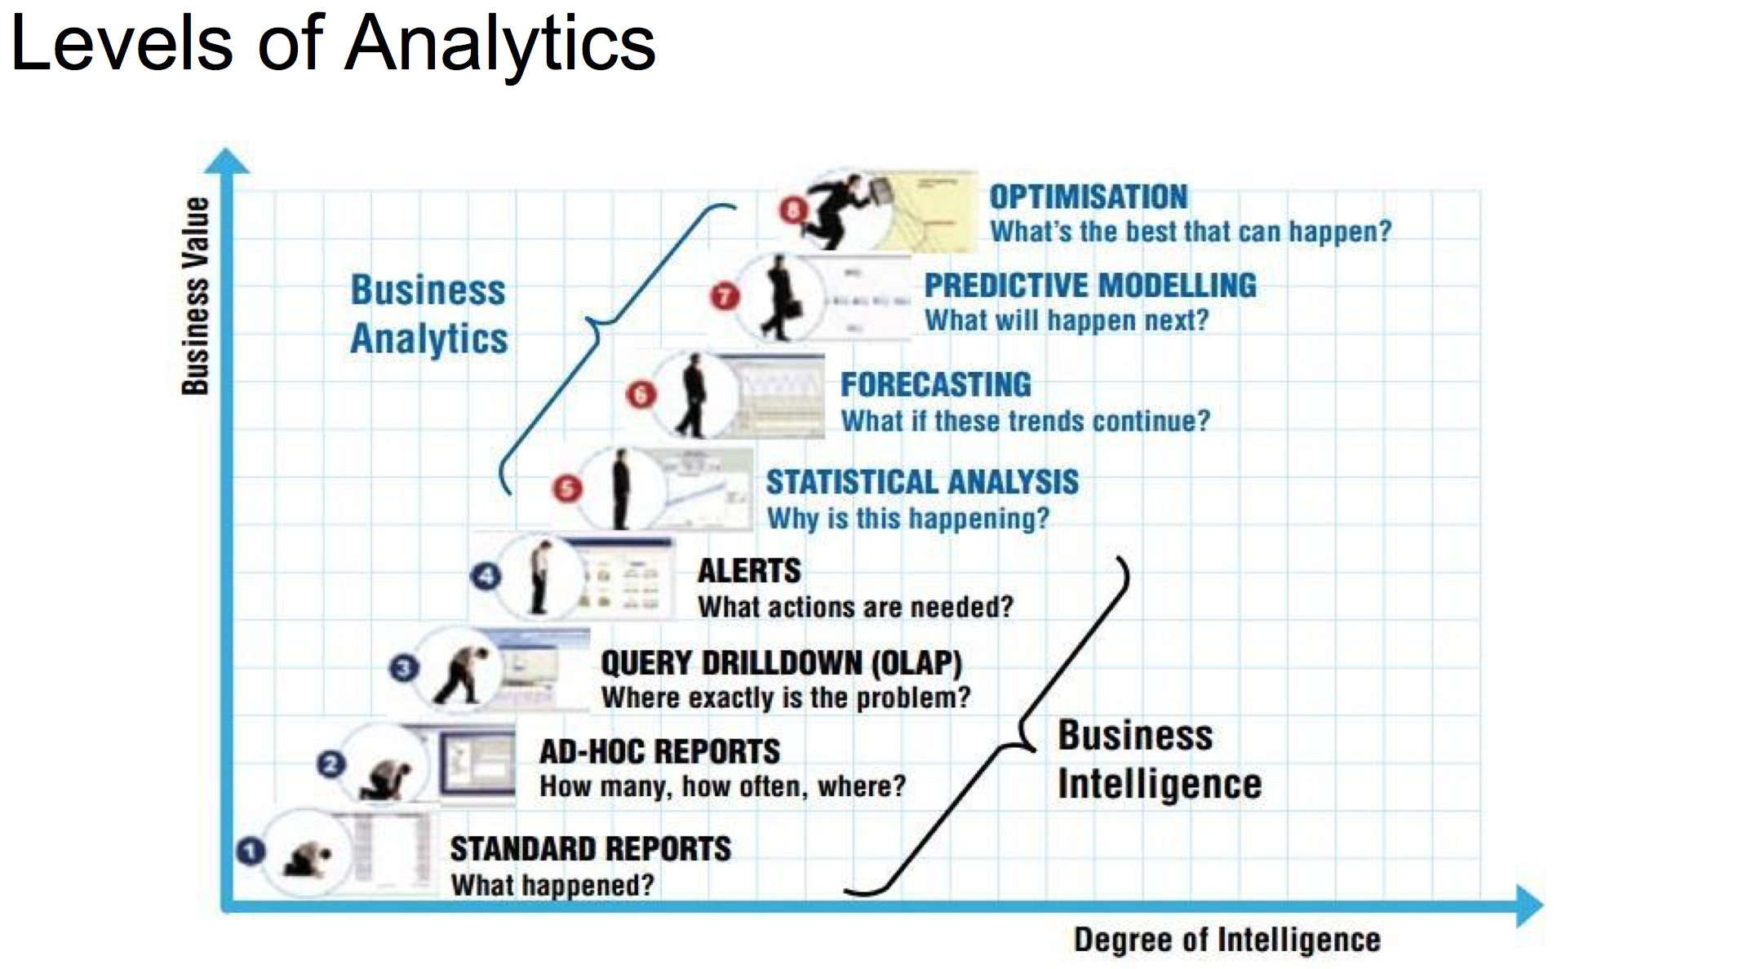
Source: https://www.sas.com/news/sascom/analytics_levels.pdf

Slide 34
What kind of analysis does your office do?

Slide 35
15 min break

Slide 36
4 Types of Concerns to be mindful of
Notes:
9:25 – 9:50

Slide 37
1. Technical
Having the right tools
Having the people who can use them
Making everything work together
Potential trap: having a solution in search of a problem
Notes:
9:25 – 9:50
This is by far the easiest concern to overcome as technical solutions flow from accurate problem definition and understanding of the overall mission goal. It’s rare that no technology currently exists to meet the need once that need is clearly understood.

Slide 38
2. Legal
Laws
Regulations
Practices
Potential trap: not doing something because of mistaken assumptions
Notes:
9:25 – 9:50
The strategy here is to help understand the legal concerns and ensure due diligence is performed around the legal and ethical issues in order to have the gray areas clearly understood by everyone. Often the legal concerns are much less important when the value of an approach is shown, either through a prototype or some test case that encourages the stakeholders to better define the necessary legal requirements. Often something has to be seen in order to be understood.

Slide 39
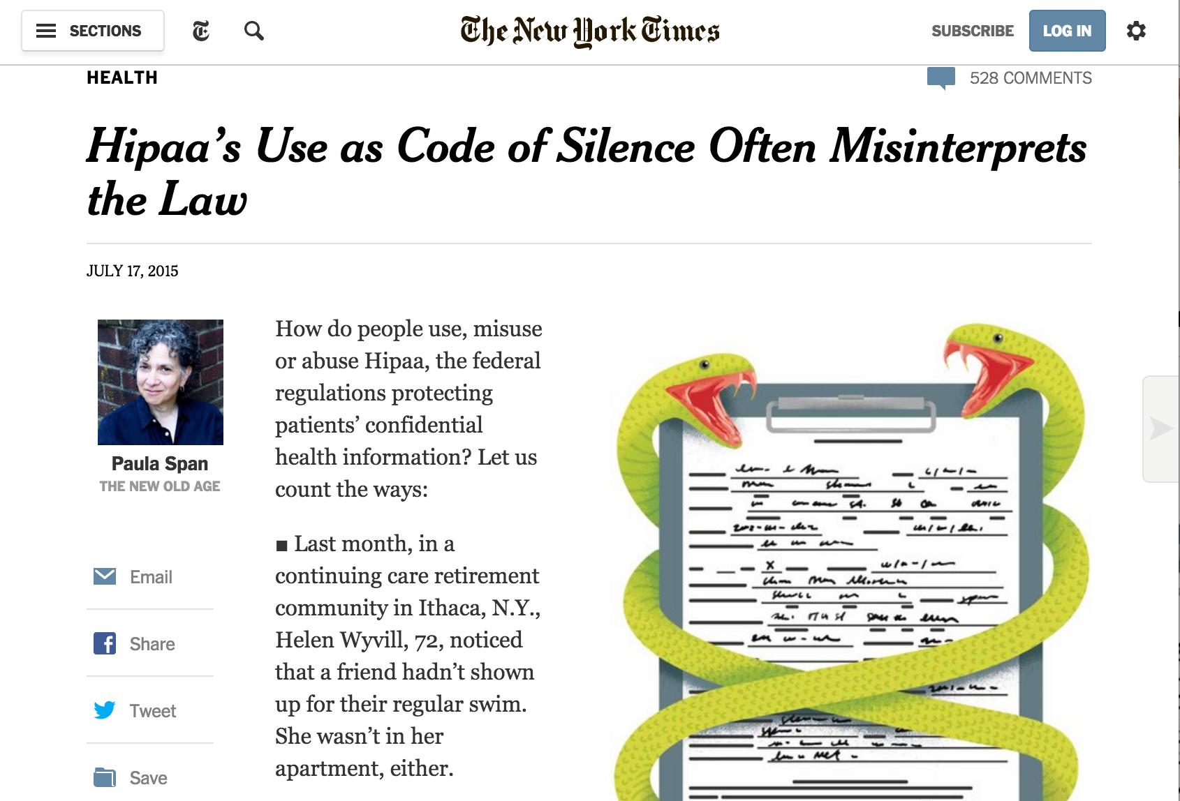
http://www.nytimes.com/2015/07/21/health/hipaas-use-as-code-of-silence-often-misinterprets-the-law.html?_r=0

Slide 40
3. Cultural
“We’ve always done it this way”
“I’m not sure I understand how this works”
Potential trap: being afraid of rocking the boat
Notes:
9:25 – 9:50
Like with the legal concerns, these tend to flow from legitimate concerns about the integrity of the mission and the organization as a whole. As city agencies, failure is not an option as it is in private industry, so there is a necessary caution to all that we do, but that isn’t an excuse not to adapt and change over time, provided that change is validated through a careful attention to the needs, mission, and goal of the organization. Like with the legal concerns, the need is for something to be seen in order for the stakeholders to understand the opportunity. This best comes with the “low-hanging fruit” that easily shows value and establishes the benefit of a more analytical approach.

Slide 41
4.Political
Inter-departmental
Intra-departmental
Public relations
Potential trap: not putting the necessary effort into something that will pay dividends to your agency and ultimately to the city as a whole
Notes:
9:25 – 9:50
Often political concerns can be vexing, but as public servants, we have a responsibility to how our organizations look to the public through the lens of the media, as well as to other stakeholders, both internal to the organization and to external stakeholders, such as other agencies, the Mayor’s Office, and other elected officials. This often means managing the perception as well as the substance of the analytical work we do. To do this, the risks must be understood and properly planned for. Often the political will to do something is gained through a pilot or other test case where the benefits can be readily seen and sufficient will can be mustered through a shared understanding of the positive outcome.

Slide 42
Do you have an example of this?

Slide 43
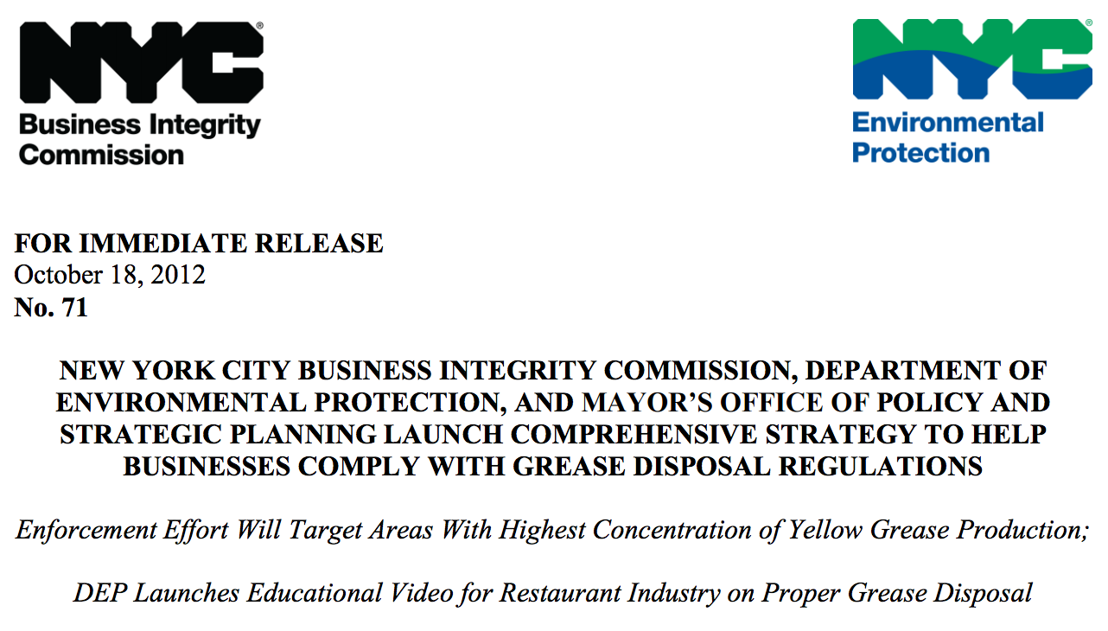
Benefits
Time, money, lives saved
http://www.nyc.gov/html/bic/downloads/pdf/pr/nyc_bic_dep_mayoroff_policy_10_18_12.pdf
Notes:
9:25 – 9:50
While there are challenges, it’s important to understand the use of business analytics can dramatically increase how government operates, often for the better in many measureable ways.

Slide 44
Benefits
Time, money, lives saved
Better delivery of services to stakeholders
Notes:
9:25 – 9:50
While there are challenges, it’s important to understand the use of business analytics can dramatically increase how government operates, often for the better in many measureable ways.

Slide 45
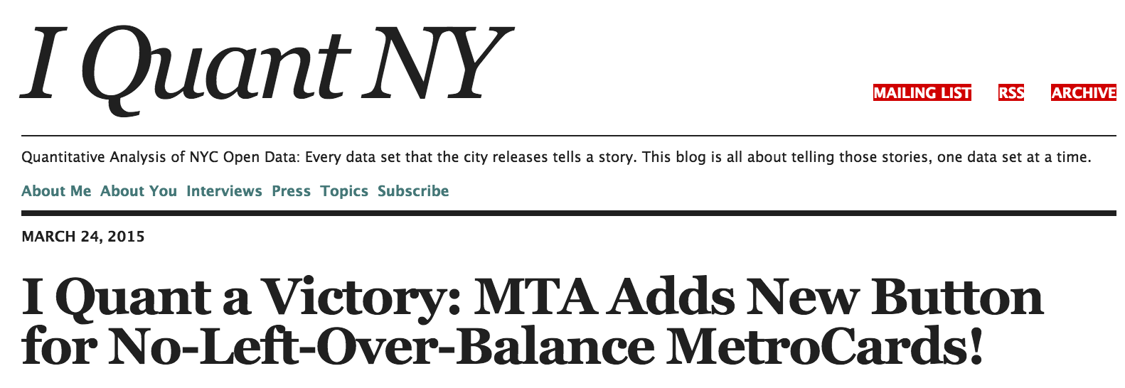
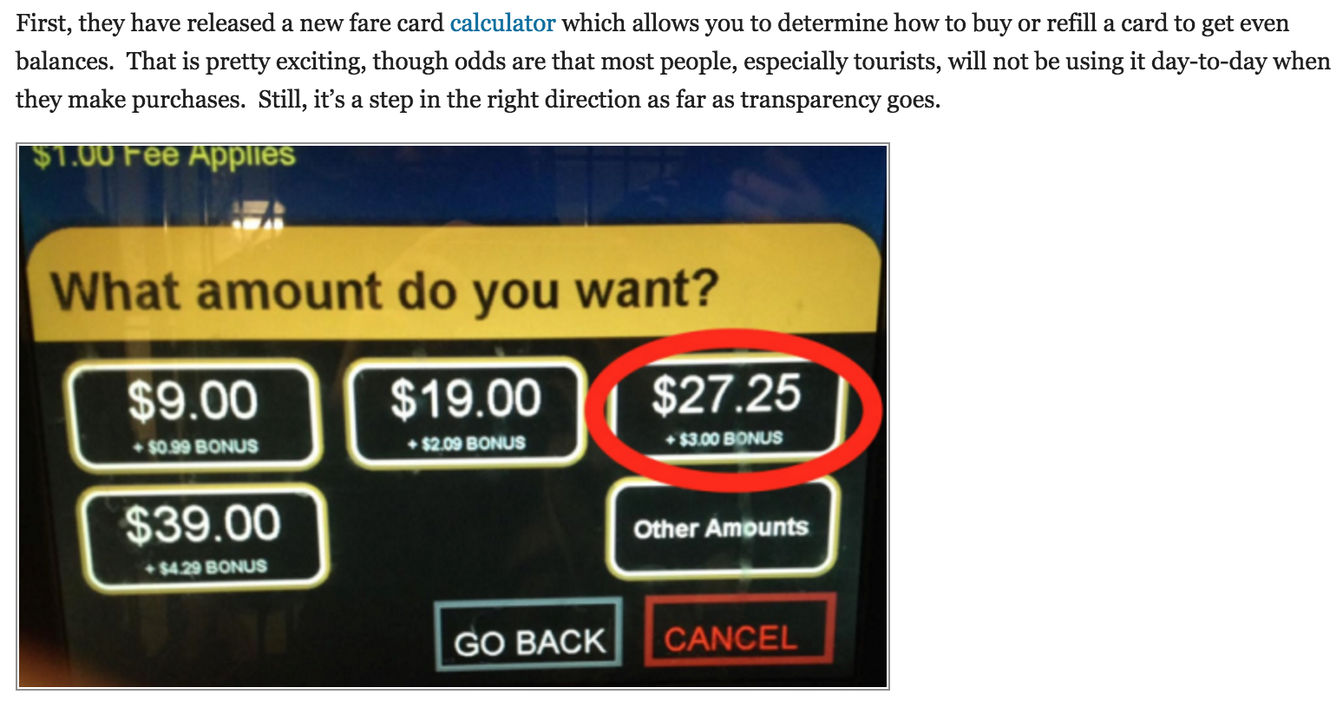
http://iquantny.tumblr.com/post/114470101209/i-quant-a-victory-mta-adds-new-button-for

Slide 46
Benefits
Time, money, lives saved
Better delivery of services to stakeholders
More transparency
More accountability
Notes:
9:25 – 9:50
While there are challenges, it’s important to understand the use of business analytics can dramatically increase how government operates, often for the better in many measureable ways.

Slide 47
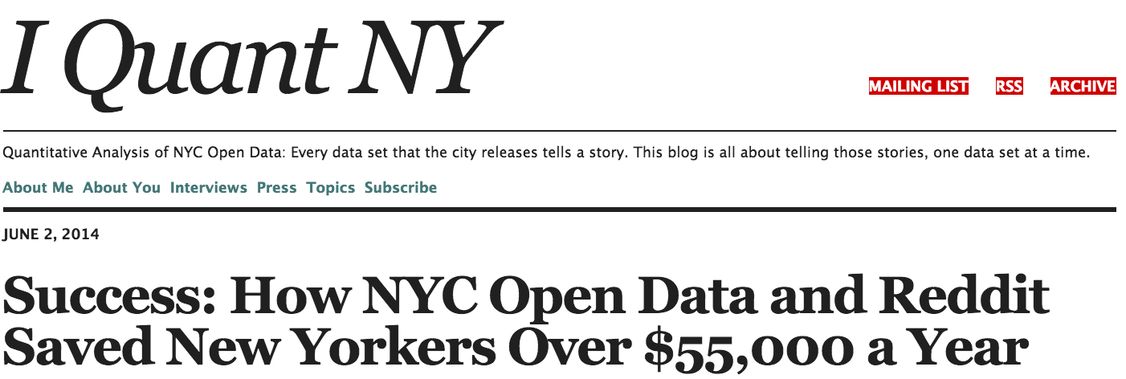
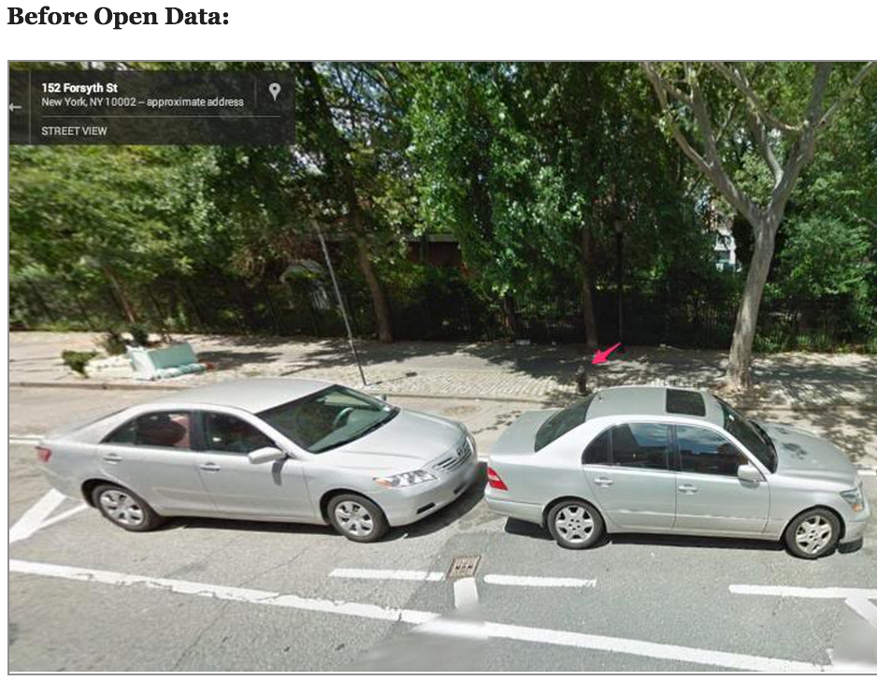
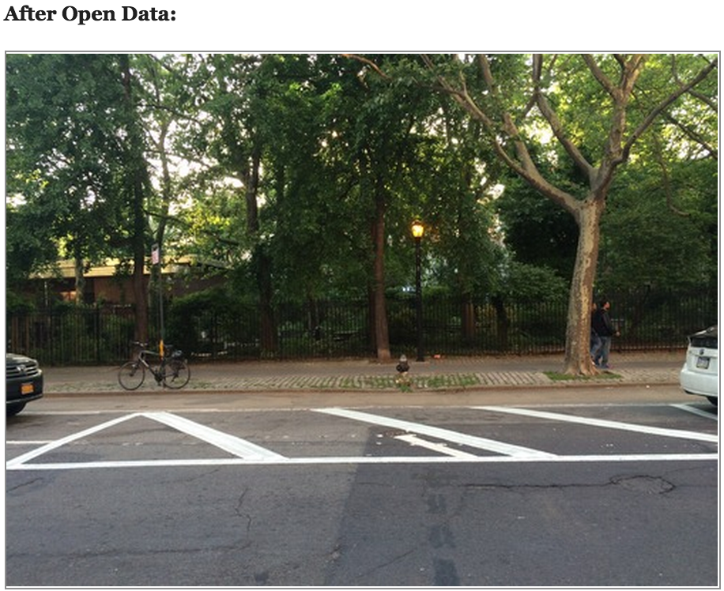
http://iquantny.tumblr.com/post/87573867759/success-how-nyc-open-data-and-reddit-saved-new

Slide 48
What concerns do you have with respect to analytics in your job? What are some of the benefits of good analytics in your office?

Slide 49
Group Exercise – Universal Pre-K
Define the analytical problem and data needs in one of these key areas
Capacity
Outreach
Enrollment (CBOs/Students)
Monitoring/Evaluation
Situation
~104,000 4-year olds in NYC
58,528 current seats
26,364 in public schools
32,164 in community based organizations
Goals
Increase enrollment by 30,000 for 2014-2015
Increase enrollment by 20,000 for 2015-2016
Notes:
10:00 – 10:25
Taking the goal of Universal Pre-K, we’ll start with an exercise to break down the parts:
Capacity
Outreach
Enrollment
Monitoring/Evaluation
Each group take one of these topics and discuss what kind of analysis would be useful to the task, what concerns must be navigated, and how the management of the process can be best supported with data.

Slide 50
presentations
Notes:
10:25 – 10:45
Each group presents their ideas around the part of the exercise they’ve been assigned and we discuss

Slide 51
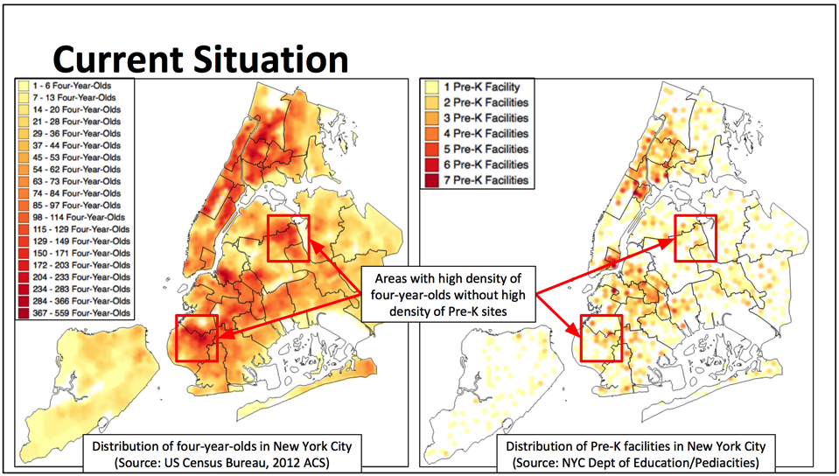
Notes:
10:45 – 10:50
This comes from a project I worked on looking at Universal Pre-Kindergarten in NYC. We mapped population data from the US Bureau of the Census 2012 American Community Survey (ACS) to the areas of NYC and compared this to the available capacity in NYCDOE’s Pre-Kindergarten program (2013-2014)

Slide 52
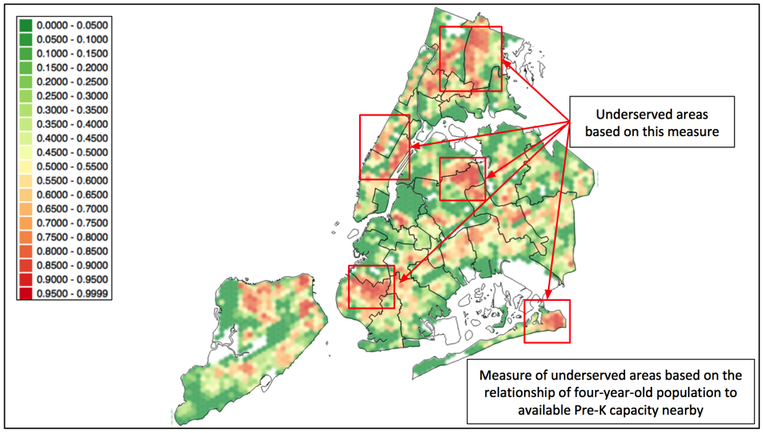
Notes:
10:45 – 10:50
This visualization represents the current measure of underserved areas across the city based on our algorithm. The boundaries represent NYC school district boundaries. The red areas represent highly underserved areas; green areas represent well-served areas. The areas with no children to begin with are transparent

Slide 53
Building a data-driven culture

Slide 55
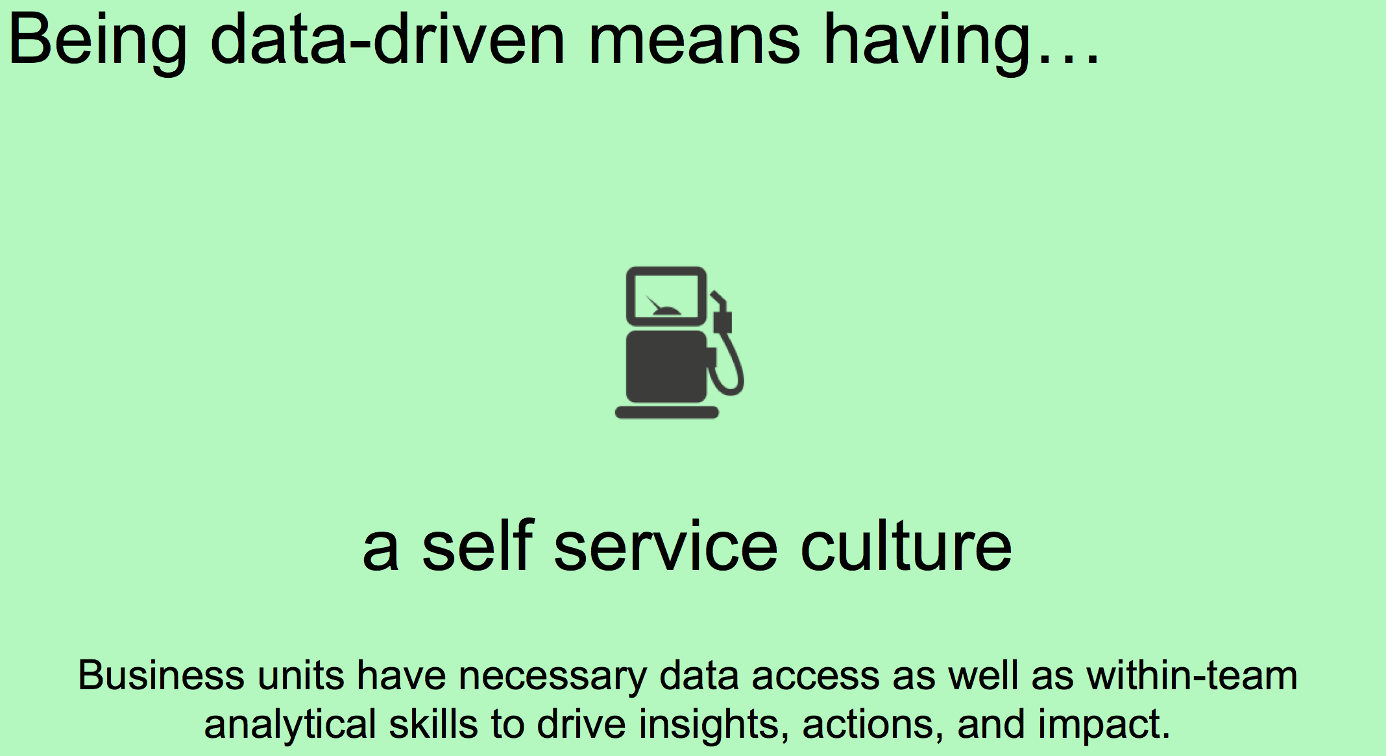

Slide 56

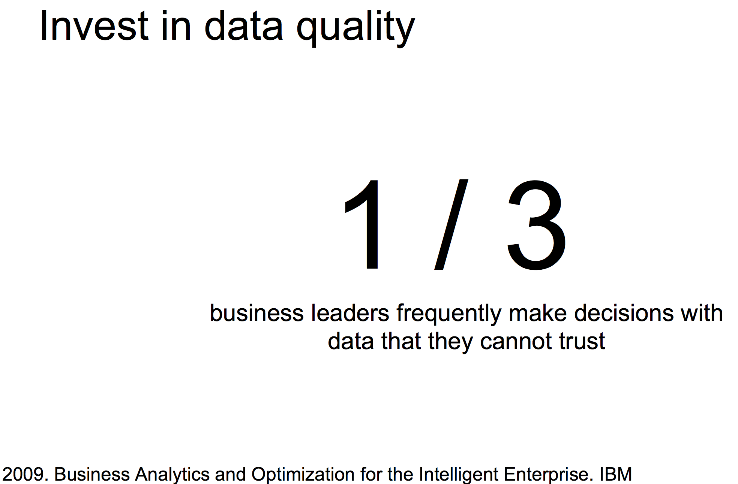

Slide 57
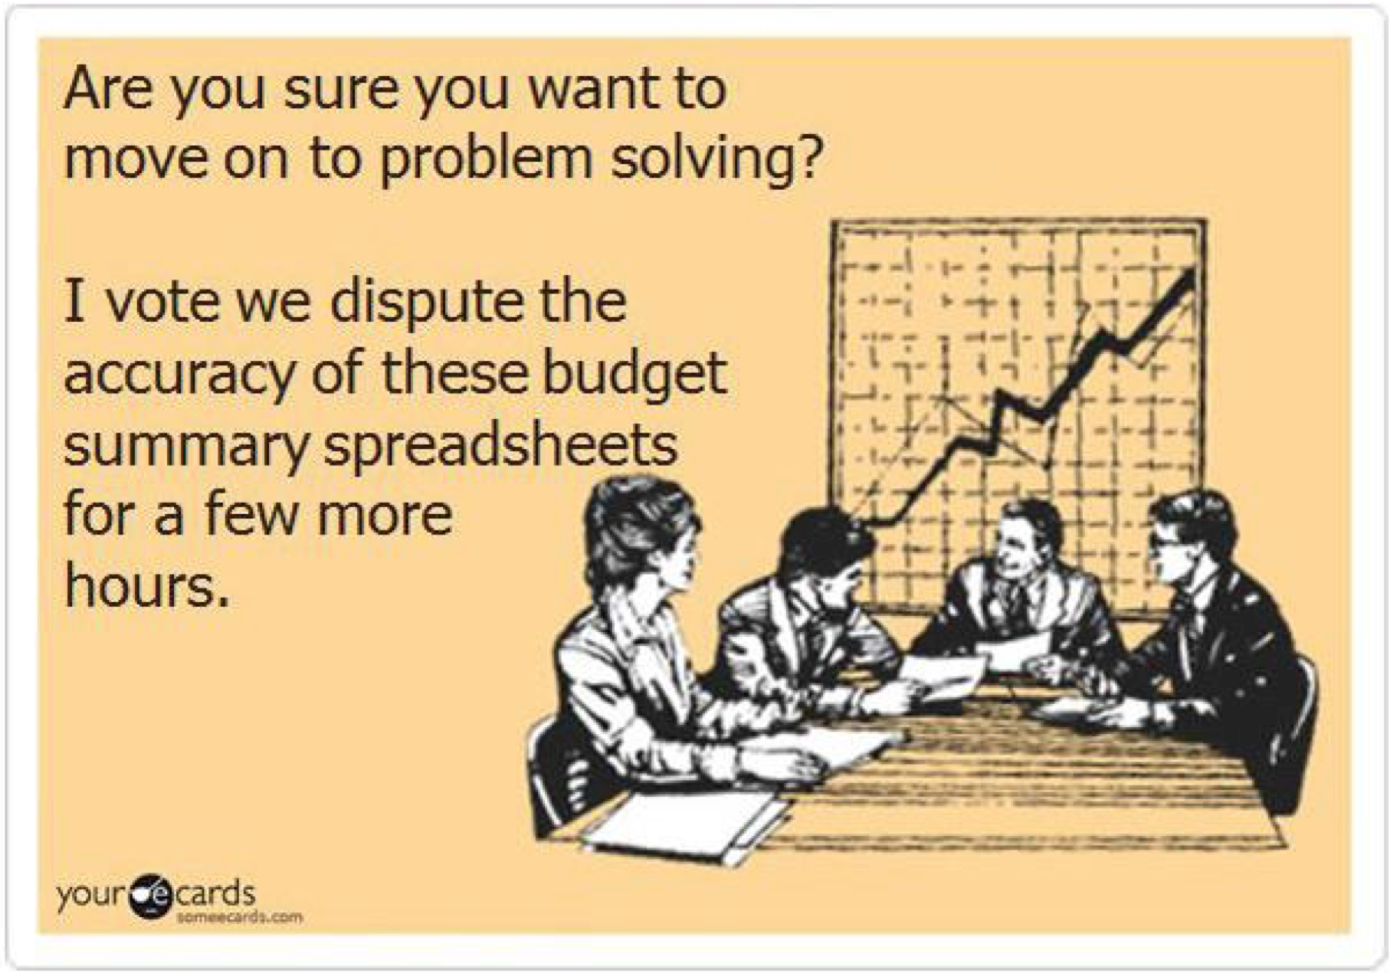

Slide 58
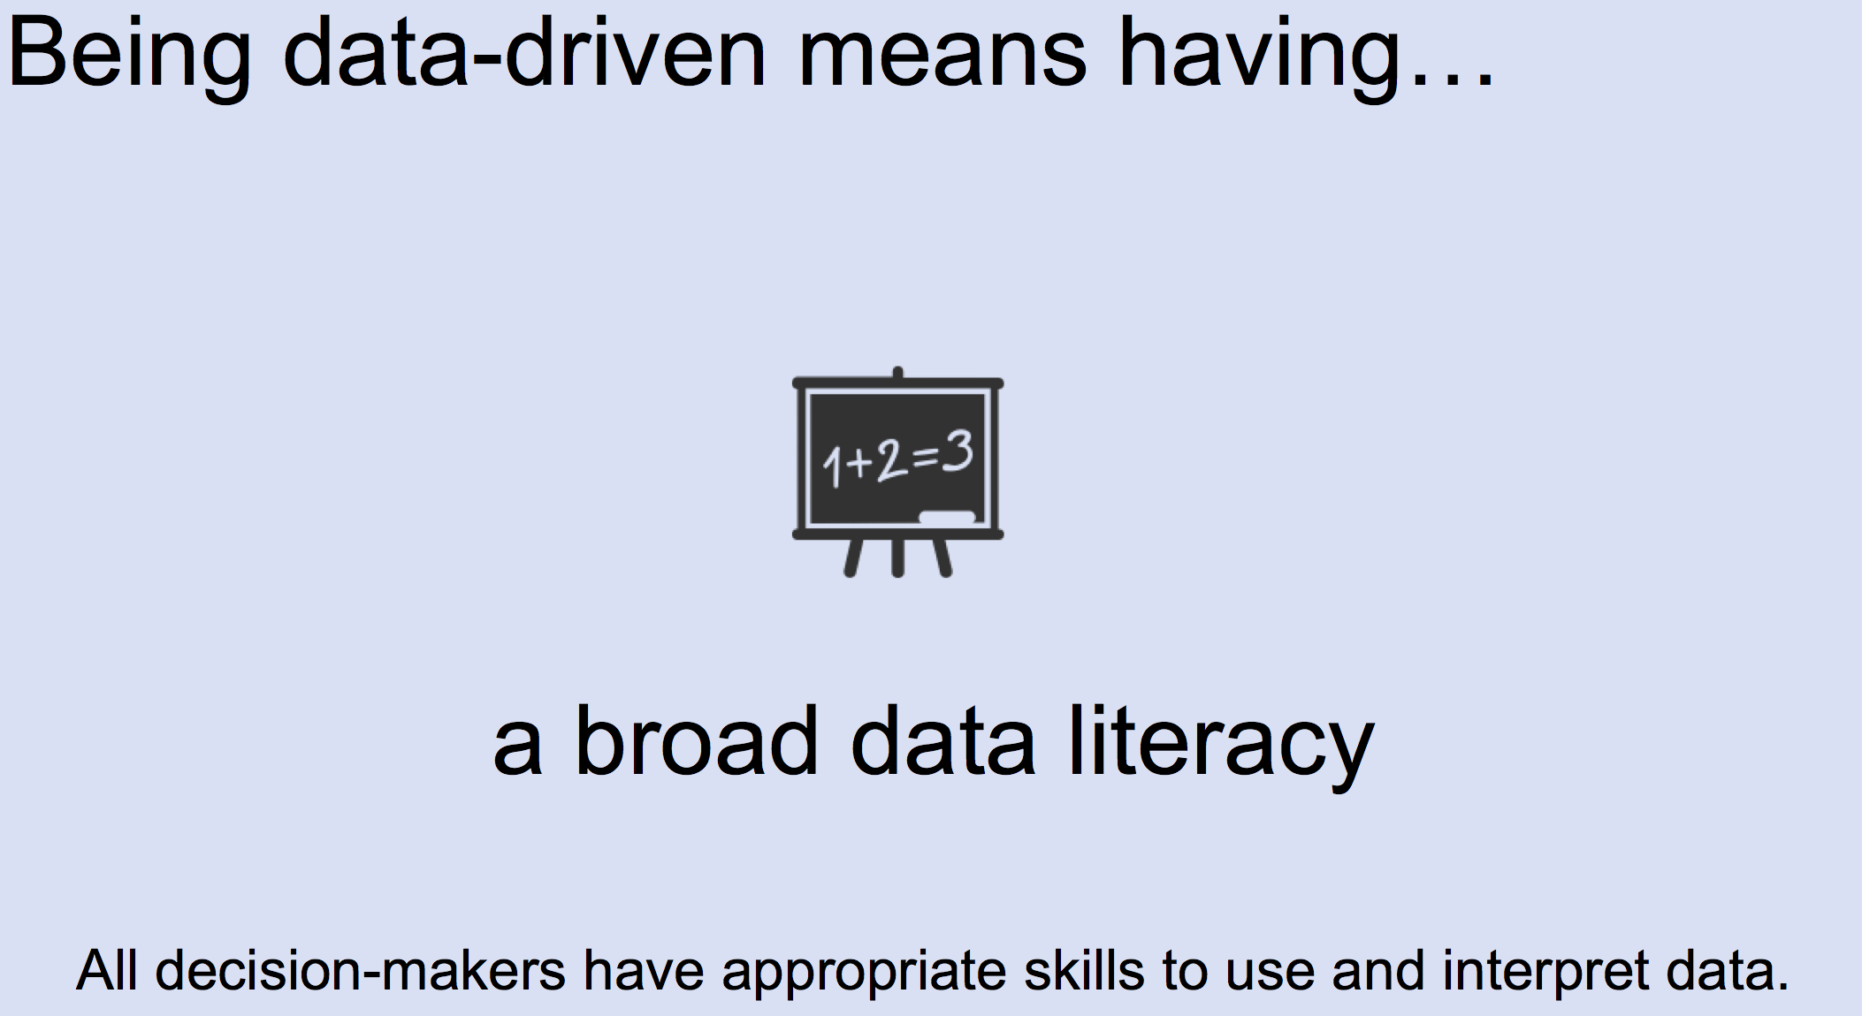

Slide 59
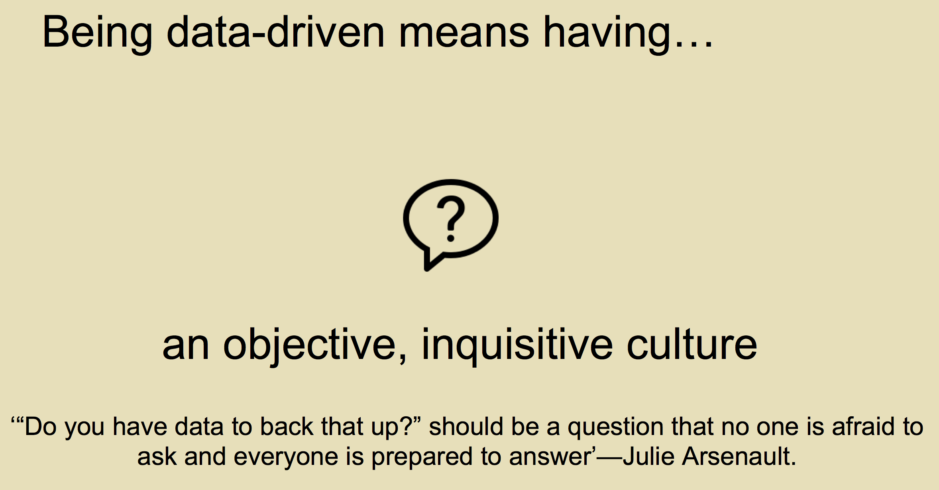

Slide 60
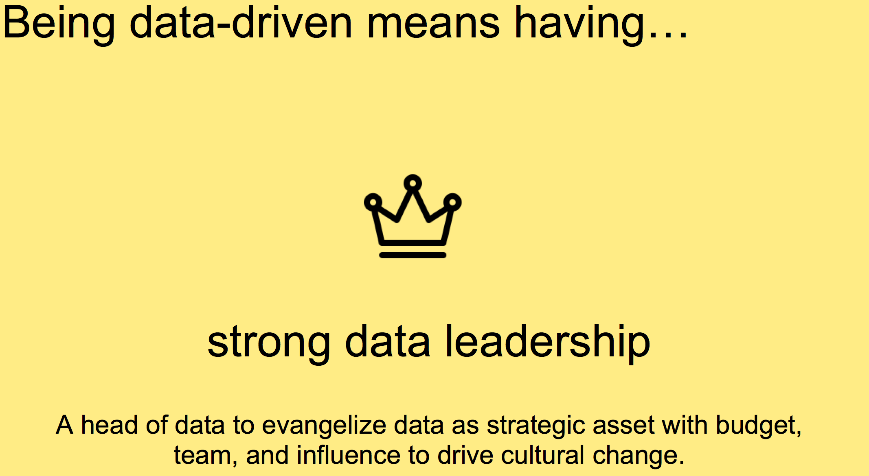

Slide 61
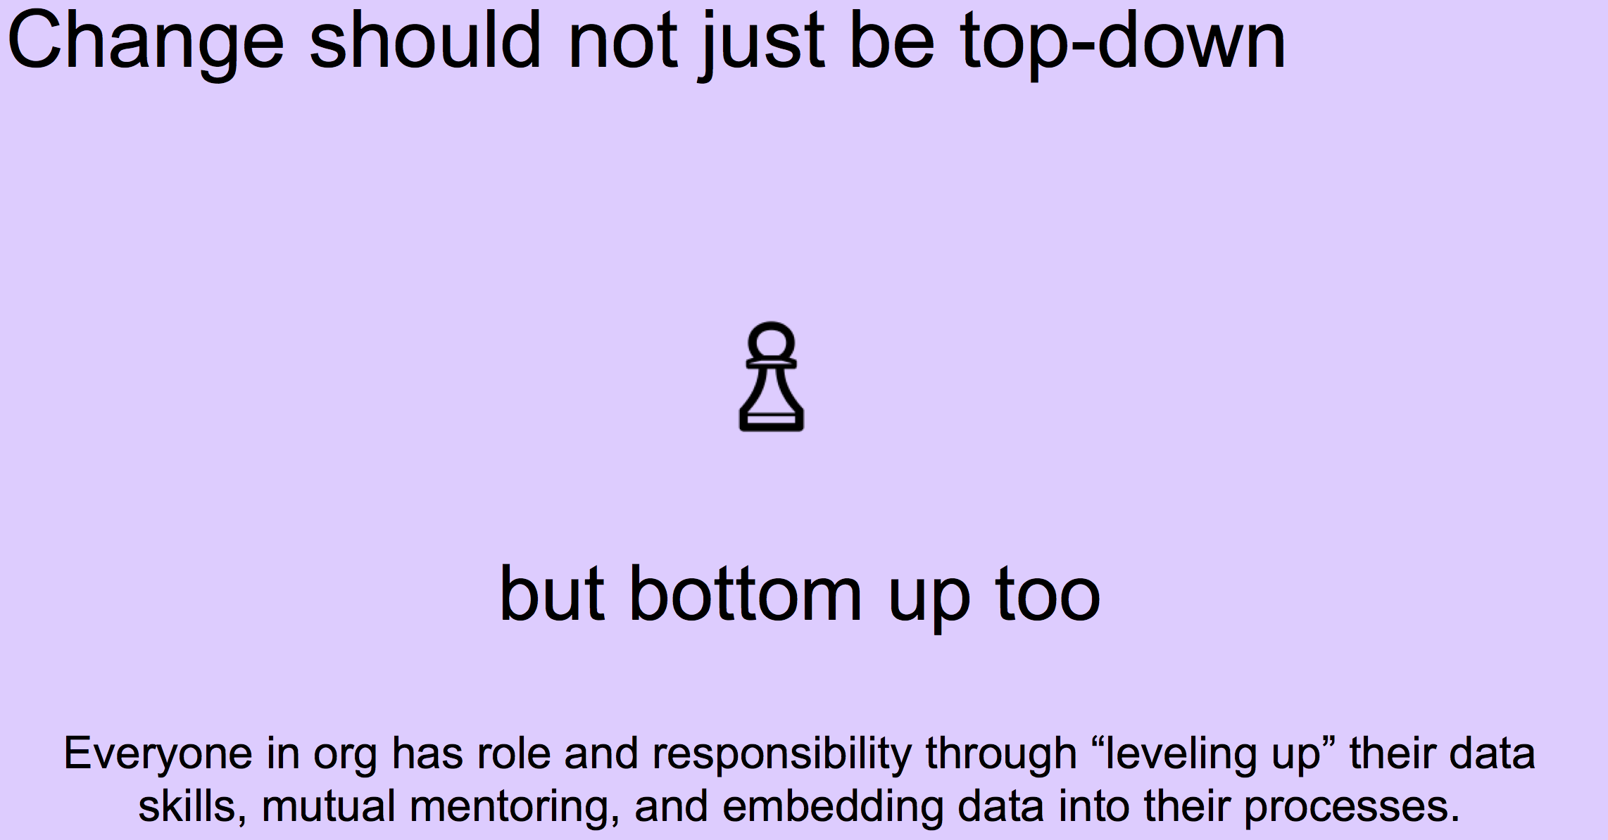

Slide 62
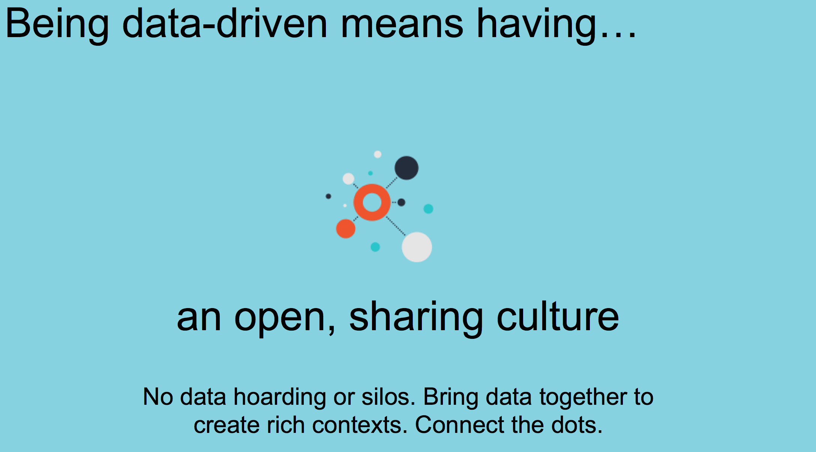

Slide 63
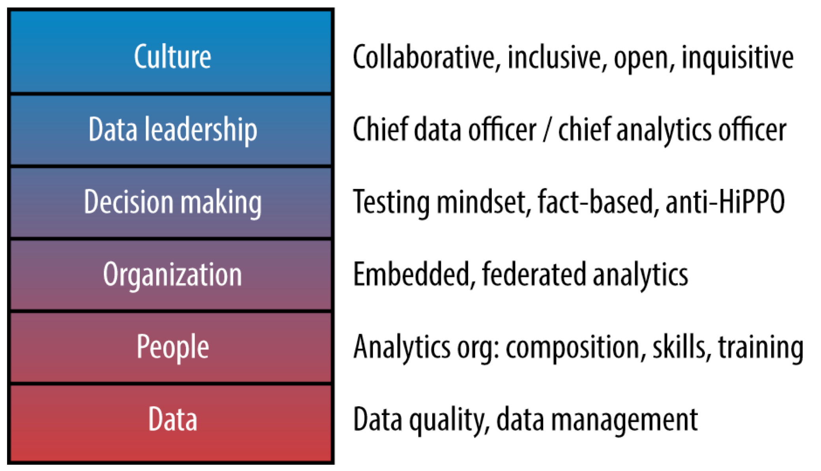

Slide 65
Wrap-up
Notes:
11:50 – 12:00
The intention is to bring everyone back to our initial goals and review what we’ve covered in the class. What did you find interesting, useful, or provocative? Also to gauge the level of engagement and get a sense of what was missed and needs to be covered in the next session.

Slide 66
lunch
Notes:
12:00 – 1:00

Slide 67
Welcome back
Notes:
1:00

Slide 68
6 Analytical Steps
Notes:
1:05 – 1:20

Slide 69
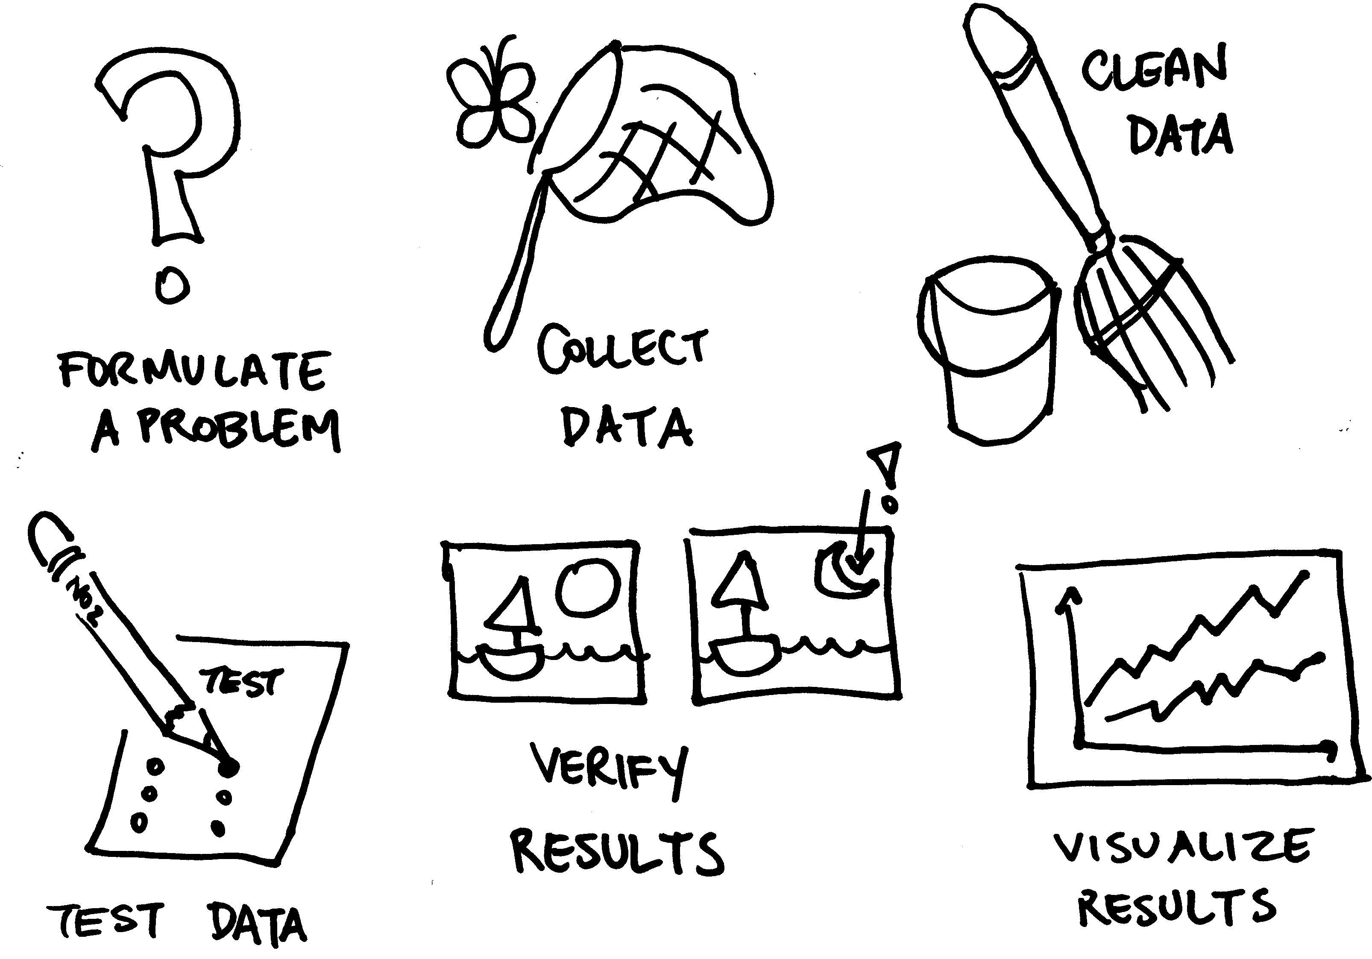

Slide 70
1. Problem Formulation
What question or need am I trying to answer?
What’s my organization’s mission and goals?
How can I best apply data to this task?
Notes:
1:05 – 1:20

Slide 71
2. Data Gathering/Preliminary Analysis
What data do I think I’m going to need?
What condition is it in?
Does it tell me what I need?
What other data might I need?
How much work do I need to put into the data?
Notes:
1:05 – 1:20

Slide 72
3. Data Cleaning/Data Munging
Make the data usable and compatible
Takes up the most amount of time
May require more sophisticated tools depending on the state and size of the data
Notes:
1:05 – 1:20

Slide 73

http://www.nytimes.com/2014/08/18/technology/for-big-data-scientists-hurdle-to-insights-is-janitor-work.html

Slide 74
4. Hypothesis Testing
Am I getting the results I’d hoped for?
What other questions come up?
Notes:
1:05 – 1:20

Slide 75
5. Verification
Do my results make sense?
Did I make a simple mistake?
Check twice and you’ll sleep easier
Notes:
1:05 – 1:20

Slide 76

Mistakes Were Made
Credit underclassrising.net/ CC BY-SA 2.0

Slide 77
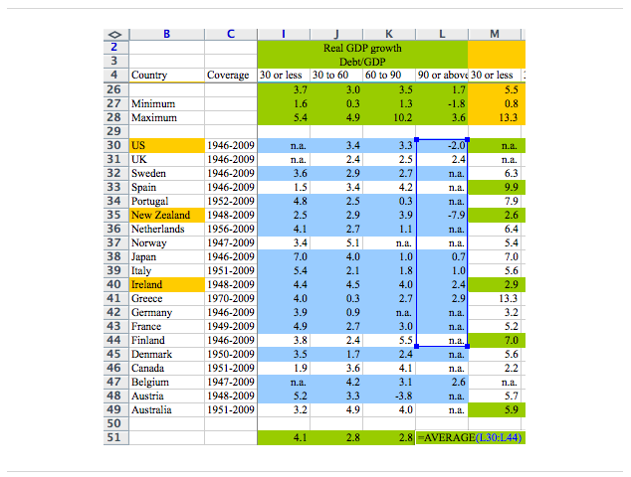
Credit Washington Post

Slide 78
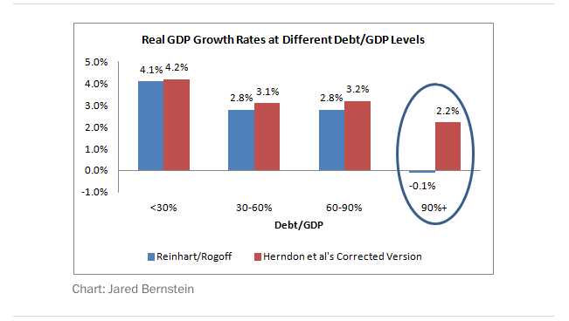
Credit Jared Bernstein Washington Post
https://www.washingtonpost.com/news/wonk/wp/2013/04/16/is-the-best-evidence-for-austerity-based-on-an-excel-spreadsheet-error/

Slide 79
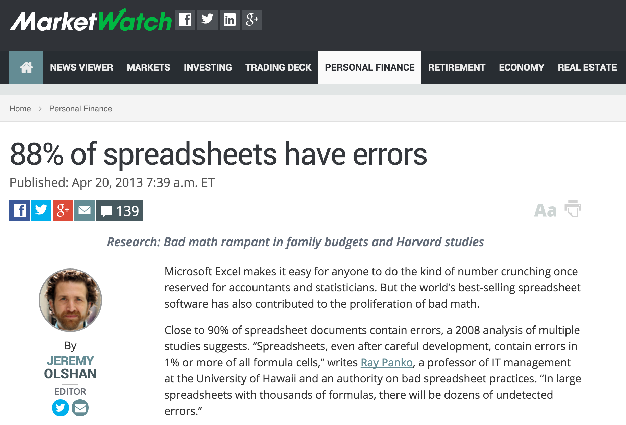
http://www.marketwatch.com/story/88-of-spreadsheets-have-errors-2013-04-17

Slide 80
6. Visualization
“A picture is worth a thousand words”
Communicate results clearly and concisely
Help to better understand your data
The eyes have a much higher bandwidth into the brain
Notes:
1:05 – 1:20

Slide 81
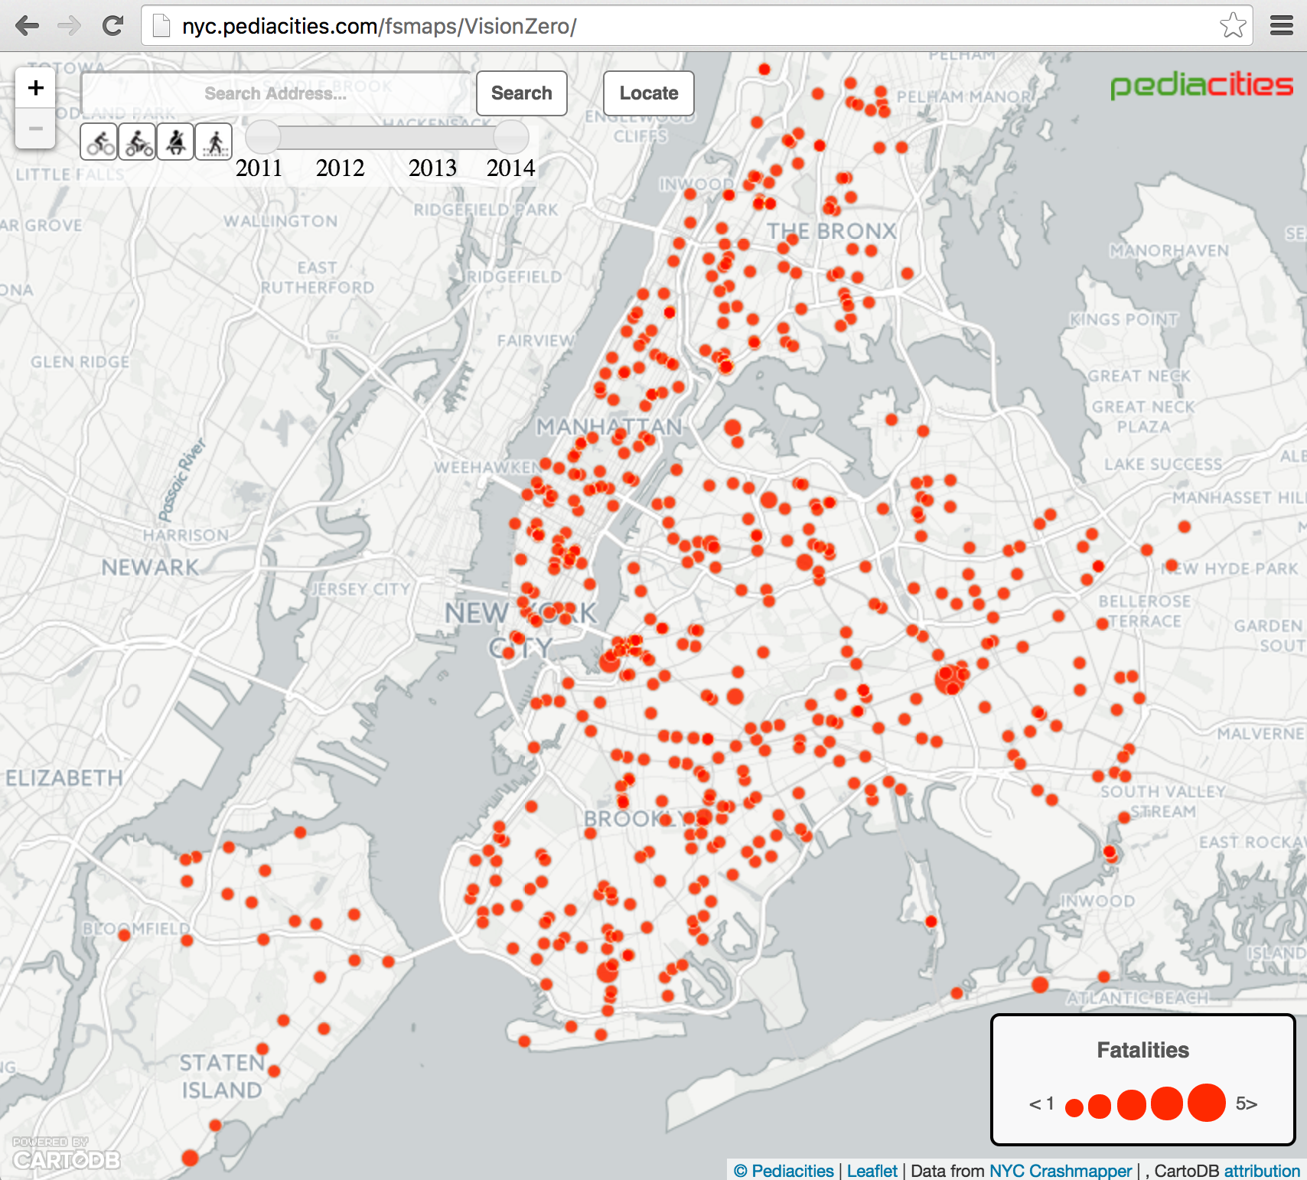
http://nyc.pediacities.com/fsmaps/VisionZero/
Notes:
1:05 – 1:20
Visualization of collision data from NYPD as part of Vision Zero. Source: http://nyc.pediacities.com/fsmaps/VisionZero/

Slide 82
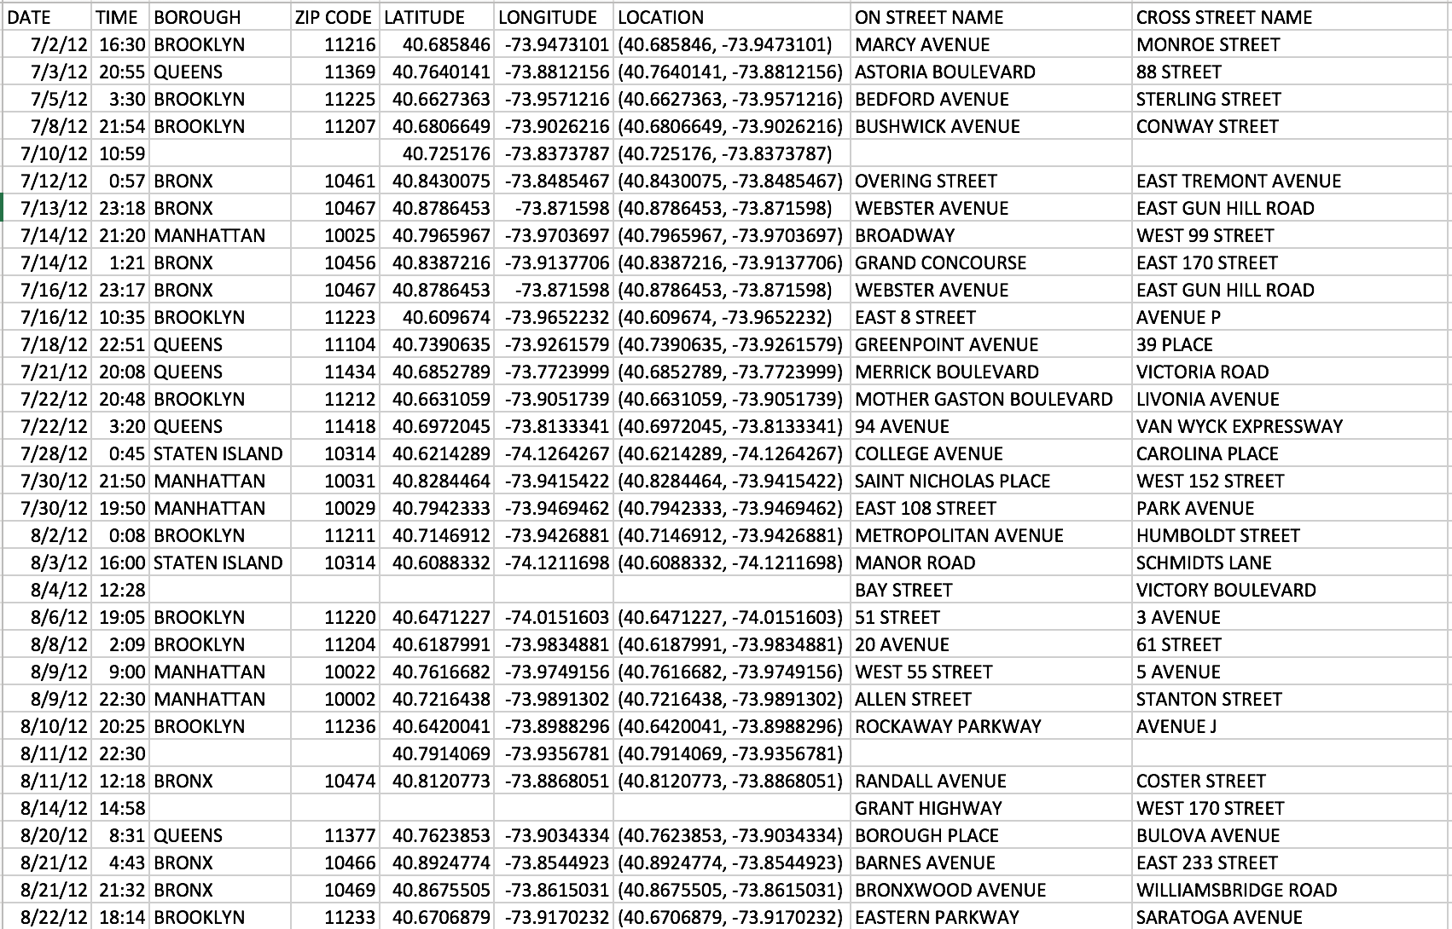

Slide 83
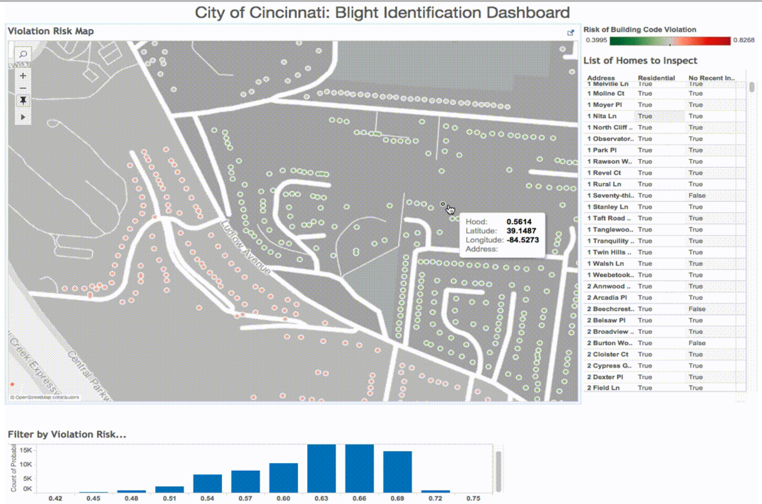
Source:
https://medium.com/backchannel/how-a-fiddler-and-an-astrophysicist-brought-predictive-analytics-to-cincinnati-c5583468f4cc

Slide 85
How does your office analyze data?

Slide 86
Definition of Open Data
Definition:
Open data is data that can be freely used, shared and built-on by anyone, anywhere, for any purpose
Key Features
Availability and access
Reuse and redistribution
Universal participation
http://blog.okfn.org/2013/10/03/defining-open-data/
Notes:
PDFs are where data goes to die. Machine readable.

Slide 87
Open Data Benefits
Transparency

Slide 88
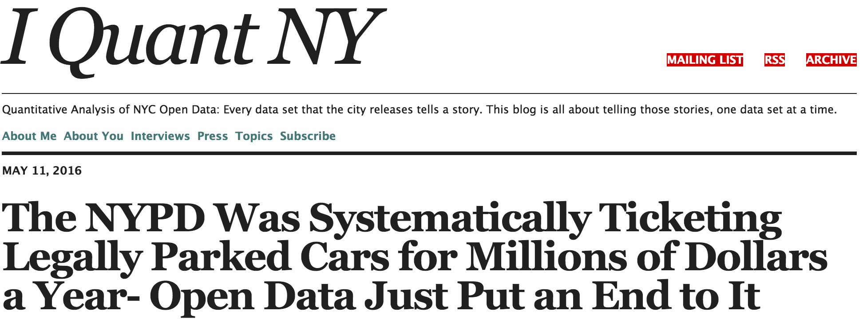
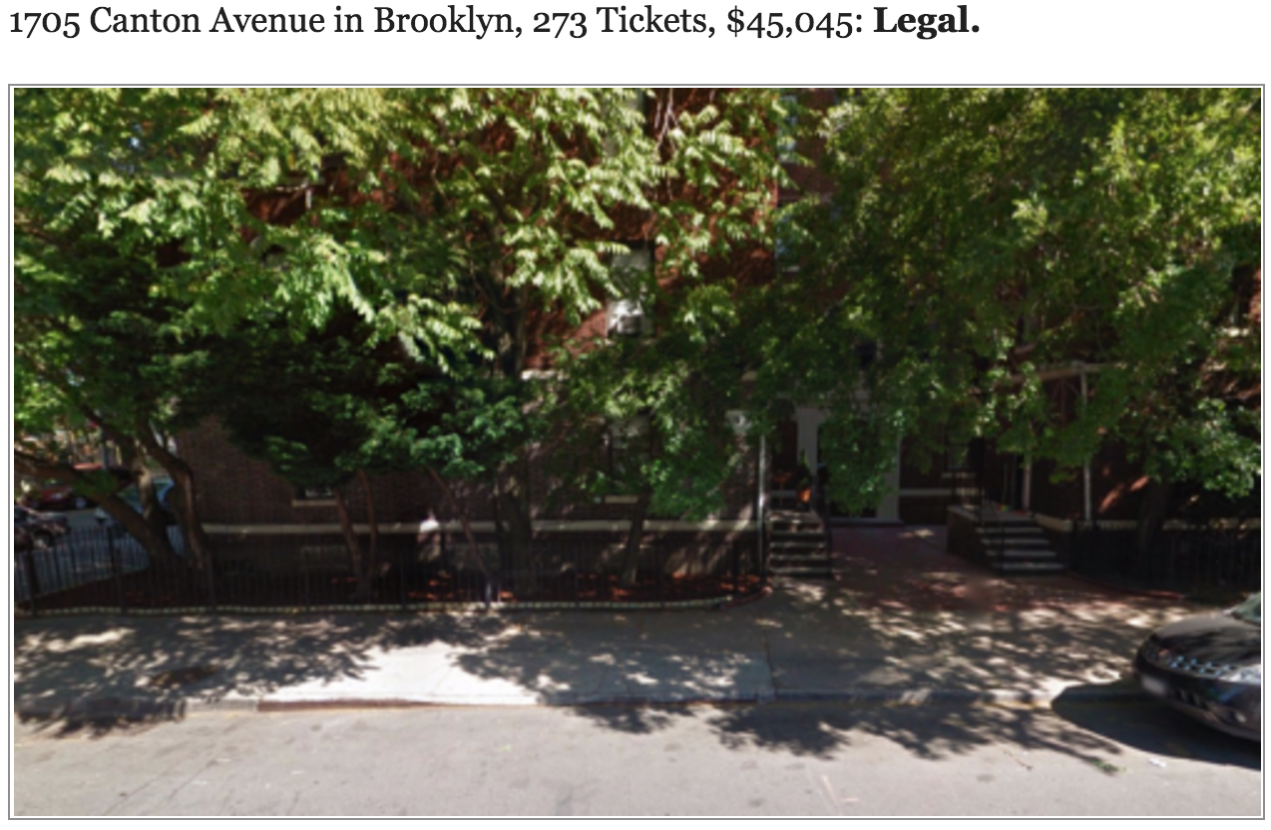
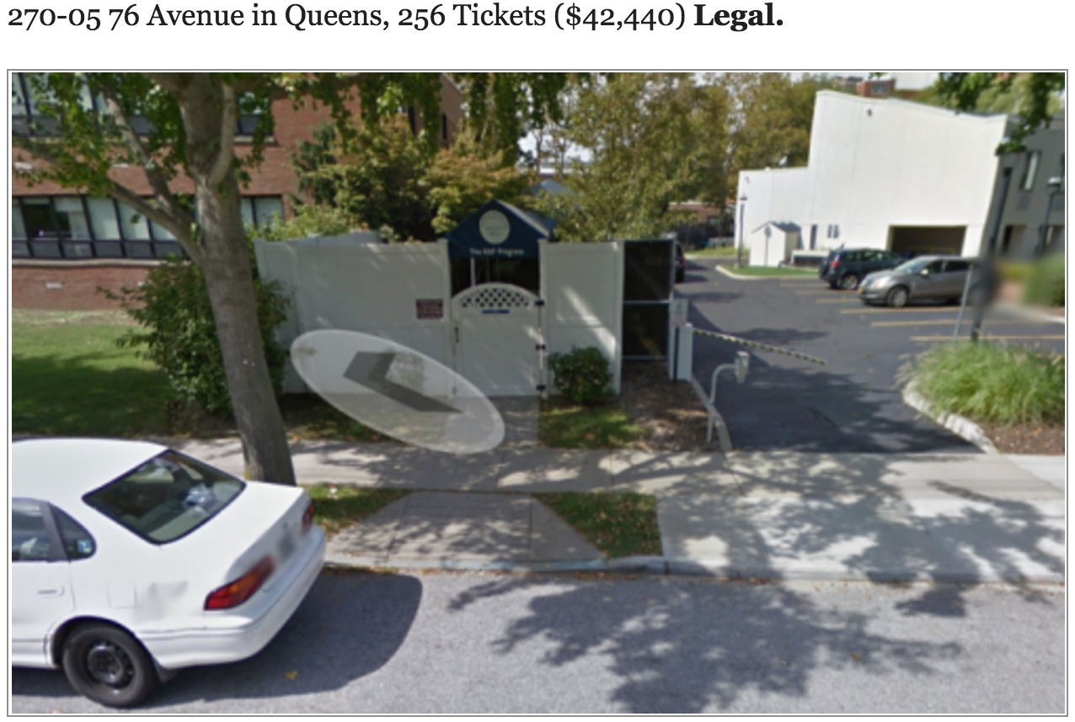
http://iquantny.tumblr.com/post/144197004989/the-nypd-was-systematically-ticketing-legally

Slide 89
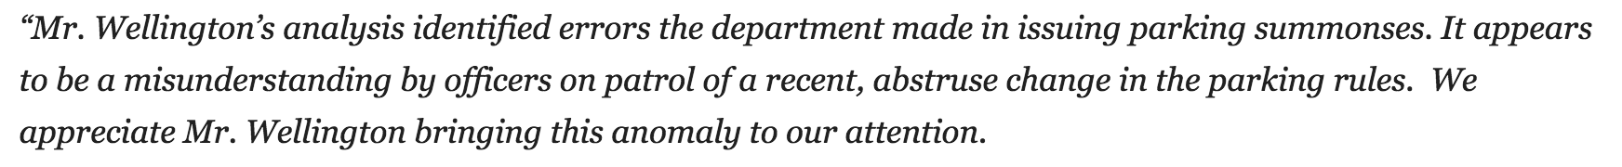
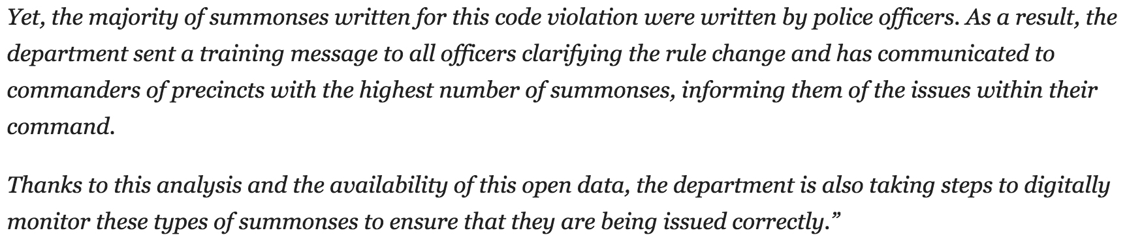
http://iquantny.tumblr.com/post/144197004989/the-nypd-was-systematically-ticketing-legally

Slide 90
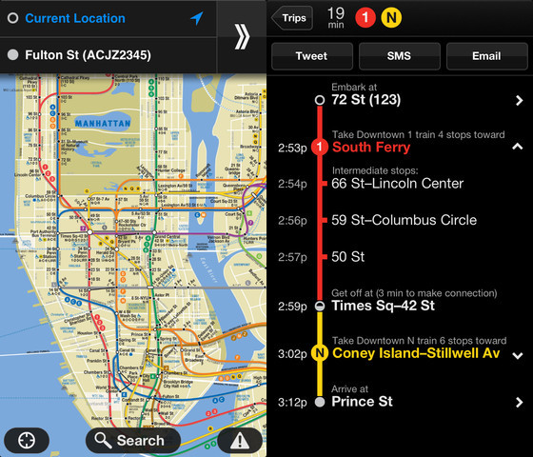
Open Data Benefits
Transparency
Releasing social and commercial value

Slide 91

Open Data Benefits
Transparency
Releasing social and commercial value
http://solarlist.com/

Slide 92

Open Data Benefits
Transparency
Releasing social and commercial value
https://healthyout.com/

Slide 93

Open Data Benefits
Transparency
Releasing social and commercial value
http://childcaredesk.com/

Slide 94

Open Data Benefits
Transparency
Releasing social and commercial value
Participation and engagement
https://www.votinginfoproject.org/

Slide 95

Open Data Concerns
Privacy
Personally identifiable information (PII)
https://www.wired.com/2013/07/mugshot-removal-extortion/

Slide 96

http://nyctaxi.herokuapp.com/

Slide 97

http://gawker.com/the-public-nyc-taxicab-database-that-accidentally-track-1646724546

Slide 98

http://www.theiii.org/index.php/997/using-nyc-taxi-data-to-identify-muslim-taxi-drivers/

Slide 99
Open Data Concerns
Privacy
Personally identifiable information (PII)
Mosaic Effect

Slide 100
Open Data Concerns
Privacy
Personally identifiable information (PII)
Mosaic Effect
Confidentiality
Security

Slide 101

http://openseweratlas.tumblr.com/map

Slide 102
Links to Open Data Portals
NYC Open Data Portal - https://data.cityofnewyork.us/
NYS Open Data Portal - https://data.ny.gov
US Federal Government Open Data Portal - http://www.data.gov/
Notes:
3:40 – 3:50
The point is to show the wealth of data available online. More data comes online all the time and it’s worth checking for data with these sources. The POC for the NYC Open Data portal is MODA. They help work out issues, as well as field data requests.
This is an unscripted demonstration of data sets available on:
-NYC open data portal (https://nycopendata.socrata.com/)
-NYC DCP Bytes of the Big Apple (http://www.nyc.gov/html/dcp/html/bytes/applbyte.shtml)
-NYS open data portal (https://data.ny.gov/)
-US Government open data portal (http://www.data.gov/)
-Seattle (https://data.seattle.gov/)
-Chicago (https://data.cityofchicago.org/)

Slide 103


Data for Exercise

Slide 104
5 minute break
Notes:
2:50 – 3:00

Slide 105

Borough-Block-Lot:
1001210001
Address:
1 Centre Street
New York, NY 10007
Assessed Value:
$70,771,500
Census Tract:
36061002900
Community District:
Manhattan 1
Census Blocks:
360610029004012
360610029004019
School District: 2
Latitude: 40.71306
Longitude: -74.0037
X: 983210
Y: 199016
Notes:
9:21
The multiple ways buildings are represented in data to see the diversity of data available and how different systems will “see” things

Slide 106
Exploratory Data Analysis
Goal -> Discover patterns in the data
Approach
Understand the context
Summarize fields
Use graphical representations of the data
Explore outliers
Tukey, J.W. (1977). Exploratory data analysis. Reading, MA: Addison-Wesley.

Slide 107
Exploring 311 noise complaints

Slide 108
10 minute break
Notes:
2:50 – 3:00

Slide 109
Question-Driven Analysis
Goal -> Answer a specific problem or concern
Approach
Have a question or problem in mind when analyzing data
“I need to know X”
Problem-focused discovery with the data
Notes:
2:00 – 2:15

Slide 110
Question Driven Analysis
Vision Zero (dB)
Tasks:
Given 311 noise complaint data, assist enforcement efforts by identifying community districts that have a high volume of noise complaints and the time frame enforcement resources should be deployed to combat the noise issue at its peak
Identify the prevalent types of noise complaints in these areas to guide enforcement in each community district
Notes:
2:00 – 2:15
This is an exercise in using data to answer specific questions. The idea is to use a real dataset (311 noise complaints) and answer some specific questions that relate to operational questions of interest. The emphasis is on practicing and extending everyone’s skills with Excel to perform basic analysis. While the goal isn’t to create a finished presentation, the hope is that you learn how to communicate analytical findings in a meaningful way to those who haven’t looked at the data, no matter how sophisticated your analysis.

Slide 111
presentations
Notes:
2:15 – 2:30
Group presentations of about 5 mins per group showcasing their findings

Slide 112

NYC Community Districts

Slide 113
Analytical Resources
Internal Agency Teams
Offices within your organization charged with performing analysis for internal or external stakeholders
Mayor’s Office Task Forces
Special inter-agency efforts around critical policy areas bringing together critical skills and experience in a subject area
NYC Center for Innovation through Data Intelligence (CIDI)
Conducts inter-agency research to identify areas of service need in the City of New York
Collaborates with all Health and Human Service (HHS) agencies and other City partners to improve services
CIDI values the contextual interpretation of data and respects persons’ confidentiality in its research activities
http://www.nyc.gov/html/cidi/html/home/home.shtml
Notes:
3:50pm – 4:10pm
A chance to introduce the resources available for data analysis inside and outside the city, including some of the challenges leveraging those resources

Slide 114
Analytical Resources
Mayor’s Office of Data Analytics (MODA)
New York City’s civic intelligence center
Aggregating and analyzing data from across City agencies
More effectively address crime, public safety, and quality of life issues
Uses analytic tools to:
Prioritize risk more strategically
Deliver services more efficiently
Enforce laws more effectively
Increase transparency
Notes:
3:50pm – 4:10pm

Slide 115

From the MODA 2013 Annual Report available at:
http://www.nyc.gov/html/analytics/downloads/pdf/annual_report_2013.pdf
Notes:
3:50pm – 4:10pm

Slide 116
Wrap-up
Notes:
4:10pm – 4:20pm

Slide 117
What We’ve Covered
Elements of a data-driven culture
Types of analysis
The analytics process
What else?
Notes:
4:10pm – 4:20pm

Slide 118

Notes:
2:01
A reminder that most technical questions you have can be solved by reaching out online to various forums and blogs for what you’re looking for.

Slide 119
Technical Resources
Stack Overflow
http://stackoverflow.com/
One of the best Q&A sites for technical questions of all kinds
Microsoft Office Support
http://office.microsoft.com/en-us/support/
Documentation on various MS Office products
Excel Tips
http://excel.tips.net/
Various tips and tricks for using Excel
Data Science Cheatsheet
https://github.com/govex/Data-Science

Slide 120


Resources

Slide 121
Contact Information
Instructors
Richard Dunks
Email: richard@datapolitan.com
Blog: http://blog.datapolitan.com
Twitter: @rdunks1/@datapolitan
Julia Marden
Email: juliaem@gmail.com
Website: http://juliamarden.com
Twitter: @juliaem
Notes:
4:20pm – 4:30pm

Slide 122
Thank you!
Notes:
4:30 Dismissal

Slide 123
Goals for the Course
Discuss the data-driven decision making process
Explore the role of managers and analysts in the decision making process
Introduce useful terminology around data and the data analytics process
Get some hands-on experience analyzing data
Notes:
4:10pm – 4:20pm
These are the overall goals for the day and a half session. The point is to let them know what we’ll be covering with the intention of revisiting these with the class to make sure these are relevant to what they’d like to learn and that we’re fulfilling these throughout the course.

Slide 124
Key Takeaways for the Course
Better understand the decision-making process with data
Better understand the analytics process
Better understand the value of data, particularly open data
Better understand the role of analysts and managers in the decision-making process
Notes:
4:10 – 4:20
You already know these things but through this course, you will hopefully leave with a better idea of the role all these play in making more data-driven operational decisions

